Slide 1
Natural nuclear fusion power plant
Virtually free, infinite
Renewable
Global impact
Earth’s Biogeochemical and Hydrological Cycles
Maintain
Reduce/Eliminate
Reuse
Increase/Maintain
Virgin
Renewable
Toxic
Non-toxic
Remanufacture
Socially bad
Non-virgin
Non-renewable
Socially good
Recycle
Energy/Material Flows
Energy/Material Flows
Nourish
C, H, N, O, P, S
Life’s Essential Elements
Minimize irreducible waste/leakage
Create feedstocks that do not disrupt Earth’s cycles
Notes:
All individual and business decisions and actions, no matter how small, lead to large aggregate impacts
Bring human life and activities in balance with Earth’s main cycles and finitude
Bring human-made world in balance with the natural world where diversity, resilience, redundancy, smallness, interdependence, waste-is-food, slowness are the keys to survive and thrive
There is no trash, no waste, no landfill in nature

Slide 2
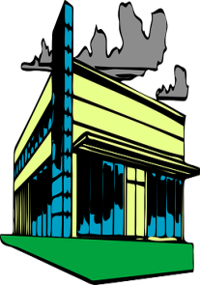
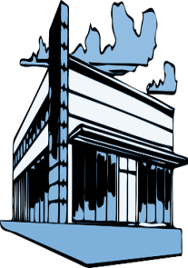
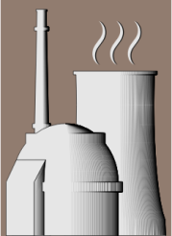
Local action
PRODUCT CIRCLES
BIO-BASED/NATURAL MATERIALS
TECHNICAL/SYNTHETIC MATERIALS
$
$
LOCAL SYMBIOSIS
Notes:
A solution to the wicked problems we have created in the last 300 years
A major opportunity for doing things differently with a positive impact on all 3 sustainability dimensions
Operates on two planes
Product circles within flows of natural and technical materials between producers, servicers and users
Growth and disposal are replaced by circles of maintenance, long-lasting value and usage
Local symbiosis connects market and non-market stakeholders with the shared goal of prosperity and sustainability for all
In both planes, waste not acceptable
For every waste flow, feedstock demand is searched or created

