Slide 1
OSCEdays Strategy Session
8th September 2017, 7pm GMT

Slide 2
Agenda
Strategy session
System diagnosis (‘needs’) – high-level
Strategic framework elements – high-level
System diagnosis – digging a bit deeper
Strategic framework elements – digging a bit deeper

Slide 3
Strategy session

Slide 4
Let’s agree on aims for the session
DISCLAIMER: we will not get as far as you’d like
ASSUMPTION: we’ll go as far as we can get, but will take as many sessions as needed. If appropriate, can set-up a subcommittee to report to BoST
Lets’ definitely get through: may feel like old ground but all too often it’s not common ground until we’ve discussed it!
Agree on premise i.e. pillars of OS and CE (do we all mean the same thing?!)
Share agreed vision and mission
Agree inferred Values
Brainstorm long-list of outcomes
Attempt to:
Shortlist and consolidate outcomes
Brainstorm long-list of outputs in support of agreed outcomes
Shortlist outputs
Derive required activities
We will not achieve:
A (full) strategic plan
A financial plan

Slide 5
Parking: in case we need to ‘park’ threads
P
xxx

Slide 6
A reminder of successes/failures to date
[Discussion / group input]
Examples:
70+ events in year 2
Some great projects initiated
Forum can be confusing to use
Contributions are reducing, centred around a few key people
Lack of quality and continuing improvements to solutions

Slide 7
High-level summary
Lots of great activity and energy…
… but have not articulated the exact challenges we’re trying to tackle…
… so we don’t know if we’re producing the right outputs, let alone the heading toward the right outcomes…
…and the inputs/resources we need to deliver them…
… so we can’t clearly communicate, provide transparency and make requests to the wider community, stakeholders and funders…
…so we need a strategy!

Slide 8
What is strategy?
An organisation’s internal response to the needs of the external environment – a ‘plan’
A description of how an organisation generates value
Thus, we must clearly articulate:
The needs / issues we are tackling
Deeper than just “linear economy”
The change we will make

Slide 9
Proposed session approach: logic model
Use the Reverse Logic approach - from Outcomes to Inputs
Ensures that planned activities logically lead to specified outcomes
Ask the question “but how?” to step back
But how?
But how?
But how?
Inputs
Activities
Outputs
Outcomes
What you invest
The work you do
Planned work
Effects of planned work

Slide 10
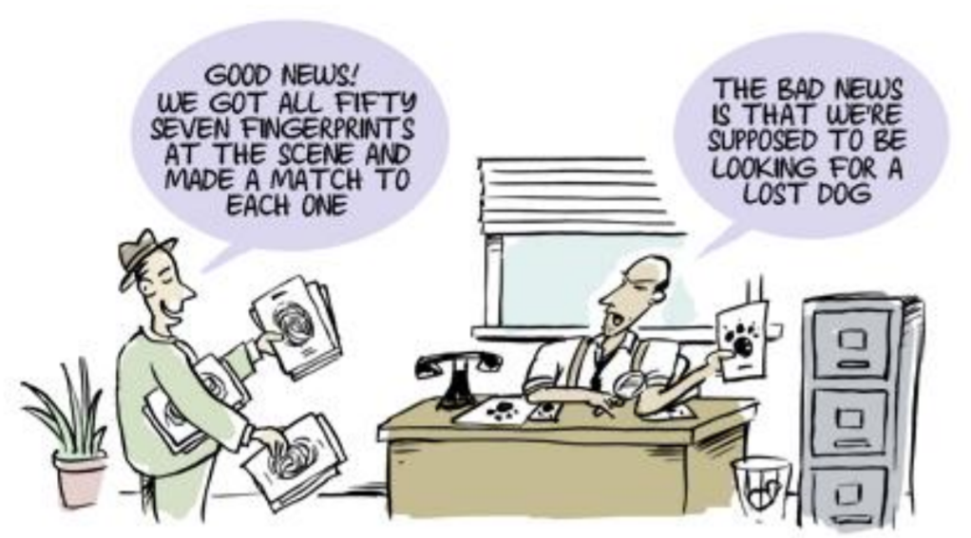
Do we really need a logic model?
Notes:
Source: Child Trends, Do I REALLY Need a Logic Model?, Sarah Catherine Williams, May 3 2015, National CASA annual conference,

Slide 11
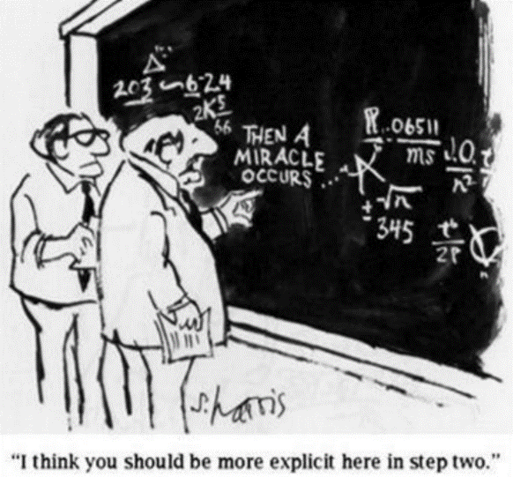
Communication with stakeholders / funders
Notes:
Source: Child Trends, Do I REALLY Need a Logic Model?, Sarah Catherine Williams, May 3 2015, National CASA annual conference,

Slide 12
An example…
Illustrative
Vision
A global ecosystem of resilient local circular economies bound by the spirit of openness, collaboration, diversity and motivation for a thriving planet and fairer society
But how?
Outcomes
Enabling environment for OSCE
But how?
Outputs
XXX policies changed or made to support OSCE
But how?
Activities
Develop a guide for policy makers to encourage them to support OSCE
Campaigns to change policy to support OSCE
Build coalitions to advocate, practice and force change
But how?
Inputs
Subject/policy volunteer experts
Volunteer translators
Contacts
Social media
Engaged stakeholders

Slide 13
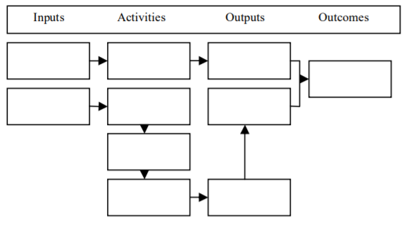
A one-page summary of strategy
Illustrative

Slide 14
Situation
xxx
Vision
xxx
Mission
xxx
Inputs
Activities
Outputs
Outcomes
What you invest
The work you do
Planned work
Effects of planned work
Guided by Values
Values
xxx

Slide 15
System diagnosis: high-level

Slide 16
Linear economy…
Assumes infinite resources and infinite capacity for waste

Slide 17
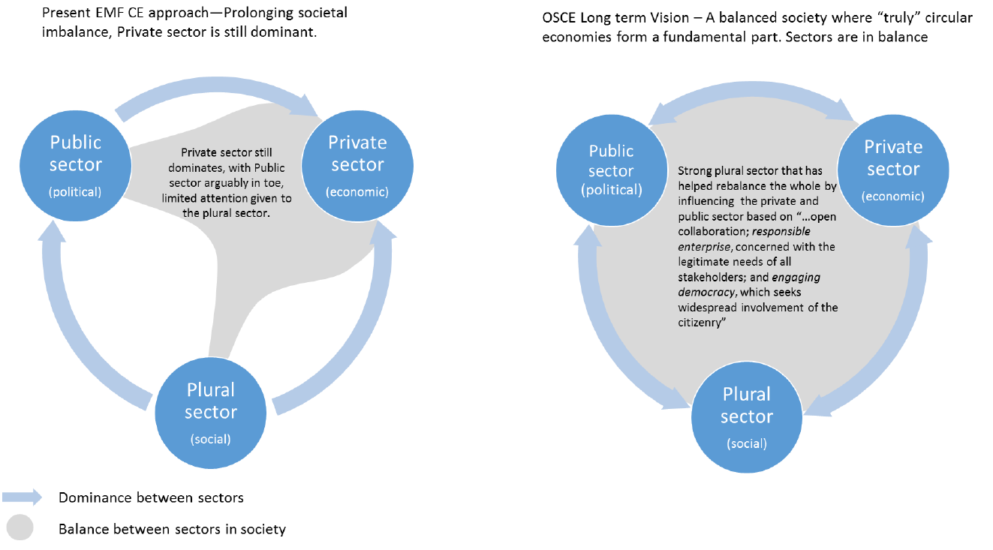
Unbalanced socio-economic system
Source: Innovation and Enterprise OSCEdays, Andy Thompson: Balancing Society (Developed from: Mintzburg, 2015)

Slide 18
Linear economy, social/economic inequality
Linear economic system: take resources faster than they can recover
Current ‘green’ approaches just slows destructive trajectory
Widespread social / economic inequalities
Need
Economic system that allows the planet to thrive while allowing equal access for all. It requires a change in how people consume and how businesses operate.

Slide 19
Spoiler alert… OSCE is the answer
Next few slides have pulled in comments from the strategic document and various things from forum. The headlines:
Circular economy is seen as the end state
Current CE trajectory lacks whole system view
Circular economy needs collaboration and equity
‘True’ CE enabled by OS – OSCE!
Do they tell a coherent story?
Do they miss a trick?
Before we go further, do we actually all agree on these foundations and definitions?

Slide 20
Circular economy is seen as the end state
Restorative and regenerative by design, it aims to keep products, components and materials at their highest utility/value at all times
A truly sustainable economy that works without waste, saves resources and is in synergy with the biosphere.
A type of economic behaviour that is desirable, especially from a material flow perspective, hinting at reduced consumption.
One that considers social aspects, as well as real economic aspects

Slide 21
Current CE trajectory lacks whole system view
Protects corporate structures: not for a thriving planet / fairer society
Business model threats: e.g. erosion of citizen autonomy, increasing producer power, information and privacy rights of citizens
Environmental impacts: not adequately addressed, missed interdependencies of economics, environment and social
Over-consumption: not adequately addressed (arguably endorses increasing consumption)
Citizens and Communities: lack of collaboration with and representation of citizens and communities

Slide 22
Circular economy needs collaboration/equity
Like natural ecosystems, it’s extremely unlikely that individual companies can construct perfect processes in complete isolation
Many multi-nationals are circularizing their supply chains - even if they all succeed, would it have much impact on global inequality?
Our ecological problems are shared by all of us – any solutions need to be shared too
Collaboration with citizens and communities is recognised as critical for climate change solutions
We need an equitable CE, democratizing CE technology so that billions at the Base of Pyramid have access to it

Slide 23
‘True’ CE enabled by OS – OSCE!
To implement closed loop resource systems, we need to share information over and above what is shared now: Open Source (OS) offers us a way
OS is not only an open (often distributed) collaboration method for developing software, hardware and design but also it is the socialization of know-how so that anyone can reproduce it
It represents access to Capital (= accumulated labor); it is thus highly aligned to CE’s principle of not wasting value – by not wasting accumulated labor.
OSCE by definition is concerned with equitable distribution of technology; we cannot divorce inequality and ecological degradation; they were created together

Slide 24
Strategic framework review

Slide 25
Vision and mission (already agreed!)
Vision
A global ecosystem of resilient local circular economies bound by the spirit of openness, collaboration, diversity and motivation for a thriving planet and fairer society.
Mission
We use and explore open source practices to create, socialize and distribute solutions globally to build local circular economies

Slide 26
Values are integral
Are our basis and embedded in our approach, interactions, focus areas
They guide how we work, who we work with and accept funding from
Founded on underlying care for community, society and environment
Values (inferred)
Openness: Captures Diversity and Respect?
Collaboration
Passion/Motivation: Captures Environmentalism and Social equity?
Innovation

Slide 27
Need
Economic system that allows the planet to thrive while allowing equal access for all. It requires a change in how people consume and how businesses operate.
Vision
A global ecosystem of resilient local circular economies bound by the spirit of openness, collaboration, diversity and motivation for a thriving planet and fairer society.
Mission
We use and explore open source practices to create, socialize and distribute solutions globally to build local circular economies
Inputs
Activities
Outputs
Outcomes
What you invest
The work you do
Planned work
Effects of planned work
Guided by Values
Values
Openness Collaboration Passion Innovation

Slide 28
Back to system diagnosis: a deeper dig

Slide 29
What needs / gaps are we trying to meet?
[Discussion / group input]
What needs / gaps do we see and want to fix?

Slide 30
What needs / gaps are we trying to meet?
Cheat sheet: Illustrative and non-exhaustive
Demand / consumption reduction
Lack of OS and/or CE knowledge / information
OSCE not seen as financially sustainable
Knowledge isn’t free
People/communities not empowered with opportunities / ways to improve lives
Current CE focus still on profit, not on society
Lack of self-sustaining OSCE champion
Barriers to engage fully with OSCE
Current CE focus still on profit, not on environment
Lack of OSCE innovation
Lack of organisations tackling OSCE in distributed, global form
Lack of clear benefits of effort required to pursue OSCE solutions
Lack of proven commercially viable OSCE products
High quality of product materials for continued cycling
Lack of government support / effective legislation
Lack of skills (design, systems thinking)
Lack of platform
Controlling product life cycles efficiently
Lack of impact metrics
(CE / social)
No access to tools / materials to pursue OSCE
Lack of stakeholders across sectors / supply chain
engaging and collaborating
Making linked industries resilient
Quality of OSCE solutions not high: no game changers
Lack of evidence of OSCE at scale

Slide 31
Translate to Outcomes
[Discussion / group input]
Statements of descriptive end-states (not actions)
What will it look like as we progress?
Try to consolidate and aim for no more than a few

Slide 32
Translate to Outcomes
Cheat sheet: Illustrative and non-exhaustive
Enabling environment for OSCE
Distributed OSCE production sites
A self-sustaining OSCE organisation and global community
People are enabled to make a living with OSCE
Trailblazer communities (‘chapters’?) based around OSCE
De facto OSCE champion
Improve communities and peoples’ lives with OSCE
Large scale understanding of “OSCE”
A lasting, evolving and enabling infrastructure
Large body of OSCE evidence, knowledge and guidance
Communities transition to OSCE production
Scale through partnership working
Policies changed in support of OSCE
Scaled impact via OSCE integration and capacity in other organisations
Break down barriers for people and organisations to participate in / contribute to OSCE
Greater transparency in supply chains
Championed products that can be understood, taken apart and repaired
Shape / contribute to OSCE debate
Increased OSCE participation
A resilient network of OSCE stakeholders with their own identities and focuses
Standardised processes and formats
Improved quality of solutions
Fostered dialogue from further afield, enhancing OSCE with wider views
Greater OSCE innovation
A network of OSCE research centres

Slide 33
What outputs support the desired outcomes?
[Discussion / group input]
What will it look like as we progress?
Statements of tangible outputs
As few as possible but as many as needed to support outcomes
Notes:
Establish a policy precedent (along the lines of existing governmental F/LOSS policies). For example:
"Funds earmarked for Circular Economy, or government projects focused on Circular Economy, must use and produce open source solutions wherever possible. Where apparently not possible, documentation and explanations must be provided to back up such claims."

Slide 34
What outputs support the desired outcomes?
Cheat sheet: Illustrative and non-exhaustive
A SELF-SUSTAINING OSCE ORGANISATION AND GLOBAL COMMUNITY
BREAKDOWN BARRIERS OSCE PARTICIPATION/CONTRIBUTION
ENABLING ENVIRONMENT FOR OSCE
Set of inspirational, clear and concise communication/education materials
A crowdsourcing/collaboration platform for people working on OSCE
XXX freely available, easy to follow solutions
An OSCE design / innovation guide
XXX campaigns to change policy
XXX active local chapters in towns & cities
An OSCE app
A guide for policy makers
A guide to constraints/freedoms local chapters have to showcase their own identities
XXX research papers
A guide to reducing consumption
XXX research centres
A OSCE stakeholder map
Resources for OSCE innovation (software, databases, tools)
A OSCE stakeholder list
$$$ contributed to OSCE organisation
XXX policies changed or made
Git-like distributed version control & documentation system
Become a decentralised autonomous organisation that has a sustainable income (beyond grants?)
XXX coalitions to change policy
Examples of large-scale, industrial collaboration on OSCE
XXX standards based on OSCE
XXX coalitions to deliver scaled solutions
XXX local events on OSCE solutions
Software to enable manufacturing (hobby to industry) to measure, publish and exchange inputs & outputs
An open Cradle-to-Cradle database
XXX local events on OSCE concept
University/school curriculum about OSCE
OSCE shop
Clear set of links to useful public resources
A guide to supply chain transparency
Notes:
Establish a policy precedent (along the lines of existing governmental F/LOSS policies). For example:
"Funds earmarked for Circular Economy, or government projects focused on Circular Economy, must use and produce open source solutions wherever possible. Where apparently not possible, documentation and explanations must be provided to back up such claims."

Slide 35
What activities support the required outputs?
[Discussion / group input]
Statements of tangible actions
Notes:
Establish a policy precedent (along the lines of existing governmental F/LOSS policies). For example:
"Funds earmarked for Circular Economy, or government projects focused on Circular Economy, must use and produce open source solutions wherever possible. Where apparently not possible, documentation and explanations must be provided to back up such claims."

Slide 36
Appendix

Slide 37
A need for a circular economy
We live in a linear economic system
We take resources out of the ground, and transform them into (often hazardous) waste
We consume and destroy our own planet faster than it can possibly recover
Current ‘green’ approaches merely act as an ineffective brake on this destructive trajectory.
We’ve known about these problems for decades and despite increasing public awareness we are still nowhere near comprehensive solutions.

Slide 38
CE demands supply and demand changes
CE fundamentally challenges the current economic model:
A change in how people consume
A change in how businesses operate
We believe this is not achievable through the status quo.
The current trajectory of CE actually reinforces existing power structures and protects influential stakeholder vested interests
Our community offers a response to this.

Slide 39
CE trajectory missing/ignoring key issues
Circular economy business models pose a number of threats on a range of levels:
(Potential) erosion of citizen autonomy e.g. how does reduced ownership impact freedom of choice?
Ever increasing power is shifted into the hands of the producers (e.g. John Deere case, see blog)
Implications for information and privacy rights of new business models on citizens are not known
Environmental impacts
CE as it is unfolding is not adequately addressing environmental issues.
Misses interdependencies of economics, environment and social – cannot be treated in isolation
Over-consumption
Currently not adequately addressing over-consumption issues in society (and arguably endorses ever-increasing consumption linked to point 1).
Citizens and Communities
The CE paradigm does not adequately represent the voices of citizens and communities when this is critical for adaptation and mitigation of climate change as well as other environmental issues

Slide 40
Circular economy needs collaboration
Our ecological problems are shared by all of us – any solutions need to be shared too.
Like natural ecosystems, when we think about design and manufacturing, it’s extremely unlikely that individual companies can construct perfect processes in complete isolation
This is an immensely difficult, illogical way of designing a circular economy.
The most impactful opportunities in the CE involve collaboration with citizens locally. Collaboration with citizens and communities is recognised as critical to build solutions to climate change. The current CE approach fails to achieve this objective.
The only way to legitimately be able to implement closed loop resource systems is to share information over and above what is shared at the moment. OS offers a way to do this.
A more radical shift is needed – in how we collaborate, how we design, produce, distribute and use our products and the services that support them.

Slide 41
Equitable CE – not Closed Source CE
The opposite of an OSCE is a Closed Source Circular Economy.
Simplest motivation for OSCE (vs CSCE) is that it is fundamentally based on an equitable CE, it democratizes CE technology so that the billions at the Base of Pyramid have access to it
Many multi-national corporations are circularizing their supply chains right now - but even if every one of them succeeded, would that have a significant impact on global inequality?
OSCE, by definition is concerned with equitable distribution of technology. We cannot divorce inequality and ecological degradation, they were created together.

Slide 42
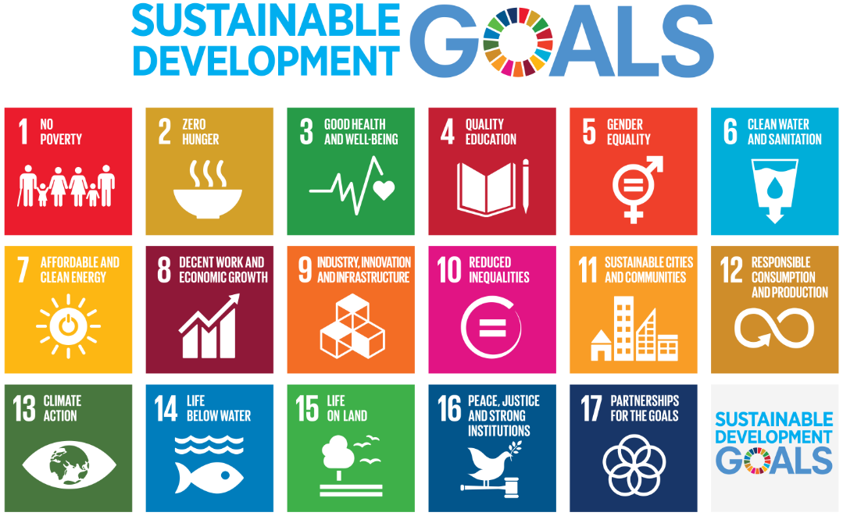

Slide 43
Values
Values are integral to all that we do
In fact they are our basis and are embedded throughout our approach, interactions and focus areas
They guide how we work, who we work with and accept funding from
They are founded on the underlying care for community, society and the environment and making positive contributions and impact towards them

Slide 44
Values (inferred)
Openness: Being open, honest and transparent with ourselves and others and being considerate of our communications, maintaining high integrity in all that we do to ensure that the approach and outcomes reflect the nature of our values. Captures Diversity and Respect?
Collaboration: Building a sharing culture and relationships that foster working with rather than for others will help support the transition to more sustainable and socially beneficial systems as well as enhances the experience! Enabling and empowering others, building capacity and learning along the way. Sharing experiences and results and breaking down barriers
Passion/Motivation: Harnessing and building on underlying caring motivations and passion for improved social and environmental outcomes drives good and better design for all. Captures Environmentalism and Social equity/inclusion?
Innovation

Slide 45
Circular economy is seen as the end state
A truly sustainable economy that works without waste, saves resources and is in synergy with the biosphere. Rather than seeing emissions, byproducts, or damaged and unwanted goods as ‘waste’, in the circular economy they become raw material, nutrients for a new production cycle.
A circular economy is restorative and regenerative by design, and aims to keep products, components, and materials at their highest utility and value at all times.
A type of economic behaviour that is desirable, specially from a material flow perspective. Furthermore it gives some hints on how to decrease or equilibrate the material flows of an economy (production of goods) to make it more ecologically sustainable (Social aspects, as well as real economic aspects are not discussed most of the time)

Slide 46
OS is seen as an approach
OS: is a successful collaboration method for developing software, hardware and design. It is based on transparent (and often distributed) development, and the open sharing of files and solutions. It can also describe certain business models, product focus (rather than service) and financing.
Open source means publishing how things are made, such as a recipe, software code, production data, or design files so that anyone can study, use, and build upon this information. This often occurs through decentralised and distributed collaboration: diverse groups discussing project ideas, giving feedback, fixing bugs, prototyping solutions and building useful, customisable software, hardware, tools and culture.
From the Free/Libre Open Source Software underlying most of the internet to Wikipedia and Open Street Map, we can see that such distributed collaboration can do great things. We can use the tools and techniques developed in this tradition to work together in an international and interdisciplinary way. Following success in the world of software, the open source model has now grown into an ever-widening movement, open design, and open data to open government.
Is a way of producing goods (not services, and this is important). We tend to call open source to everything. So Open Source is so far Open Software and Open Hardware, both orbit around use values (products) and how they are made (know-how). This is more important than collaboration itself.
Firms collaborate internally or with partnerships as well, thus collaboration is not enough to describe OS. What makes the difference is the socialization of (know-how) so that anyone can reproduce it.
Is basically access to Capital (Capital = accumulated labor). When we are talking in CE about not wasting value we are talking about not wasting accumulated labor.
Notes:
https://oscedays.org/open-source-circular-economy-mission-statement/

Slide 47
OSCE – a true CE enabled by OS
We believe that a sustainable, waste free, circular economy needs transparency, open access to information and open source solutions. We believe that with Open Source, a Circular Economy is possible.
OS is a strategy to enable fast transition to a CE “ecological steady state”. OS is related to changing production, and activating distributed, socialized, democratized production vs centralized, inefficient, monopolized production.
It is a strategy that is also more suitable to create local economic resilience and development.
OS economic agents with low capital could develop and overcome scarcity without waiting for big investments, corporations, etc.

Slide 48
OSCE
Why open source approach to CE? Our ecological problems are shared by all of us – any solutions need to be shared too.
A future where every product is designed for multiple cycles of use, and different material or manufacturing cycles are carefully aligned, so that the output of one process feeds the input of another. Rather than seeing emissions, manufacturing byproducts, or damaged and unwanted goods as ‘waste’, in the circular economy they become raw material, nutrients for a new production cycle.
Open source means publishing how things are made, such as a recipe, software code, production data, or design files so that anyone can study, use, and build upon this information. This often occurs through decentralised and distributed collaboration: diverse groups discussing project ideas, giving feedback, fixing bugs, prototyping solutions and building useful, customisable software, hardware, tools and culture.
From the Free/Libre Open Source Software underlying most of the internet to Wikipedia and Open Street Map, we can see that such distributed collaboration can do great things. We can use the tools and techniques developed in this tradition to work together in an international and interdisciplinary way. Following success in the world of software, the open source model has now grown into an ever-widening movement, open design, and open data to open government.
> This way of collaboration – the open source way – and the transparency and freedom it entails, is key to make a highly diverse, complex and rapidly developing economy work in cycles.
The OSCEdays is about taking a holistic approach to understanding how different systems can interact, getting to grips with the challenges we’re facing, sharing experience and inspiration openly and starting to build an n source circular economy.

Slide 49
Some suggested objectives (1)
Stimulate an Open Source-Circular Economy debate
Bring together and include a broad set of stakeholders to stimulate debate, sharing and beneficial alignment between the open source and the grassroots circular economy communities.
Take a hands on approach to create and share practical solutions
Work on defined needs and identified challenges, creating and sharing practical open concepts and solutions through an inclusive practical approach - local/ global and online/offline
Developing projects
Developing and supporting local events
Provide openly accessible circular solutions
Build a lasting evolving and enabling Open Source Circular Economy space
Explore and create a lasting space for people and organisations to be able to access, connect through, contribute to, use and build upon practical and hands on open source circular economy resources and actions – that benefit the environment, society and the economy.
A space to enable, empower and facilitate practical action and development to a circular economy
To simplify and break down barriers for people and organisations (of all sizes & from all backgrounds) to participate in and contribute to an open source circular economy.
Take hands on is very broad, are we focusing on developing projects, or take hands on in creating local events, workshops, etc.? In my case hands on has meant to go inside a concrete Open Source Development project and learn from it. Does it means for all of us to experience Open Source development?

Slide 50
Some suggested objectives (2)
Community development / foundation: Shape and contribute to the CE debate through development of citizen and community focused projects and activities based on OS
Education: Enable OSCE through outreach activities such as campaigning and evidence building and knowledge development to inform policy-making to support an OSCE
Practical actions and impact:
Establish a self-sustainable OSCE organisation and global community;
Build foundational knowledge and practical guidance on OSCE for education;
Undertake practical projects that contribute to development of OSCE concept

Slide 51
Some suggested objectives (3)
COMMUNITY / FOUNDATION
Establish the OSCEdays community/foundation as a decentralised autonomous organisation that has a sustainable income (beyond grants?)
Establish active local chapters in 100+ towns & cities (or 500+ ?)
Continue to build the OSCE association/foundation to be truly governed by a global members base
Develop a space for people to develop non-commercial or alternative projects on OSCE
A crowdsourcing/collaboration platform for people working on OSCE
People are enabled to make a living with OSCE projects
Make OSCE ‘forkable’ so that OSCE-like projects/communities can emerge with their own identity and focus
SCIENCE/EDUCATION/OUTREACH
Develop a body of knowledge on OSCE through practical projects, events, forum discussions and (to a lesser extent) analysis of the concept
Develop knowledge to make communication of OSCE compelling and understandable to support engagement
Develop an educational toolkit, curriculum and resources for anyone to use to learn and teach the basic ideas of an OSCE in an inspirational way (which are actually used!)
University-level curriculum about OSCE
Support the development of scientific research, papers, tools, resources and datasets that are available to all, to enable citizen science
PROJECTS/ACTIONS
Conceive and deliver meaningful practice-focused projects that clarify and demonstrate the concept of OSCE e.g. develop
Practical and shareable resources e.g. toolboxes for sustainability in makerspaces
A Git-like distributed version control & documentation system for Open Source Circular Hardware
An open Cradle-to-Cradle database (either the existing C2C database is opened, or we create our own)
Software solutions to enable every level of manufacturing (hobby to industry) to measure, publish and exchange inputs and outputs
Examples of large-scale, industrial collaboration on open source circular hardware - eg "the Linux of OSCE"

Slide 52
Some suggested objectives (4)
Establish a policy precedent (along the lines of existing governmental F/LOSS policies). For example:
"Funds earmarked for Circular Economy, or government projects focused on Circular Economy, must use and produce open source solutions wherever possible. Where apparently not possible, documentation and explanations must be provided to back up such claims."
Create a list of open international standards to promote as common ground for open source circular products
The social/people side of supply-chain transparency is interlinked with Circular Economy
The issue of consumption is addressed in both Open Source and Circular Economy
This would require proactively engaging with relevant policy / governance institutions
Becoming financially sustainable is a critical objective and should be listed as one on our website. Currently, we are kind of dabbling in OSCE.
Need a roadmap of how to achieve this and collectively assess if this roadmap is feasible. OSCE could be a cosmo-localization platform - know global, fabricate local. All our contributions can be shared across the network and innovation communities in each major city (to begin with) can become circular production communities.
Each of this projects are long-term projects. Each by them self look like a venture on its own. First recommendation would be to start using existing tools and proven approaches. For example Wikis, Git-hub, Grab-Cad. If we are creating literacy in regard to Open Source and Circular Economy we should start using the available tools, not creating new ones. After we have experience we create better solutions. We should commit to practice what we say. Instead of creating new methodologies, grab one and apply it. For instance: using IDEO’s circular design guide; applying for funds and projects; take action.
A sensible business model of how cosmo-localized innovation communities can actually achieve prosperity at very large scale if there is a critical mass of network innovation. The critical level is one in which each local innovation community in the network begins to produce significant output, large enough to start displacing a significant fraction of goods and services consumed from the mainstream economy. If we can maintain a significant year-on-year output of innovations, we can begin to lessen our capital requirement for mainstream goods and services. Theoretically, we should produce enough for each innovation community cooperative with surplus left over to sell into the mainstream market.

Slide 53
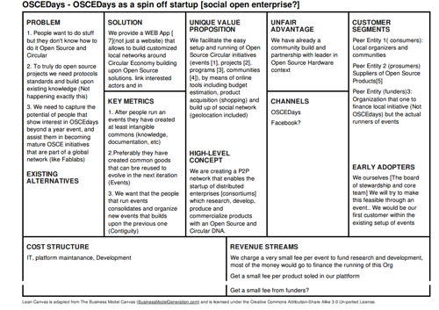

Slide 54
Lars’ vision
I like the ‘Days’ part in our name. And I like that we have some concrete resources/documentation for solutions on our homepage. Concrete solutions will help to grow and make impact. Behind most concrete solutions is an external partner.
How about we look for partners to post those concrete tutorials. We help them. And then we create a global event to celebrate each new tutorial inviting people to use it right away. For example ‘Global Smartphone Repair Day (I Fixit)’ is March 11 and around. From that day on March 11 will always be ‘Global Smartphone Repair Day’ and tutorial is available of course. But it will only be celebrated with a global event when it is published. And that way we try to fill up the calendar till it is full – and we have an ‘Open Source Circular Economy Year !’
That is our long term vision: The Open Source Circular Economy Year! And we do it step by step. Tutorial after tutorial. With partner after partner. Trying to free infrastructure and solutions. Supporting people & companies with making things Open Source, campaigning and advertising their solutions.
365 – this reflects the complexity of the goal (an Open Source Circular Economy) but breaks it down into small steps. If we are ambitious for now we could do … maybe 5 a year.
There are already ideas for future tutorials on the forum. And I got some more. They key part is that those tutorials can then be very concrete! That helps to focus. And the projects that are successful long term have usually something really concrete. Our question is to vague. An ‘Open Source Factory To Recycle Batteries’. That would make sense.
To facilitate, inspire change and provide practical action towards a circular economy by exploring, enabling practical examples, sharing, using and advocating for an Open Source approach

Slide 55
Objectives with measures
How will we get there?
Examples:
Develop and share 365 concrete solutions
1,000 research centres globally contributing OSCE solutions
Develop university and school courses around OSCE
Take a hands on approach to create and share practical solutions
Stimulate an Open Source-Circular Economy debate
Develop and support local events
Develop and support projects
Provide openly accessible circular solutions
Shape and contribute to the CE debate through development of citizen and community focused projects and activities based on OS
Enable OSCE through outreach activities such as campaigning and evidence building and knowledge development to inform policy-making to support an OSCE
Establish a self-sustainable OSCE organisation and global community
Build foundational knowledge and practical guidance on OSCE for educational purposes
Undertake practical projects that contribute to the development of the OSCE concept

Slide 56
Approach
What are the outputs that make a difference? How do we measure success? By doing more events, or by keeping stable the amount of cities involved? By the amount of projects that are initiated in our platform?
Connect and stimulate - create practical examples
Review and evidence
Communicate and champion
Connecting and facilitating dialogue from further afield, open up to wider perspectives to identify and showcase international best-practice
Collaborate and open standards across countries and industries
Create knowledge of how resources flow throughout our system
Share and use the good solutions, build upon them and improve them, for the benefit of our planet and our society
Champion and develop products that can be understood, taken apart and repaired
Advocate and create greater transparency in manufacturing processes and material production

Slide 57
Stakeholders
BoST
Event organisers
Universities (students, researchers)
Educational institutions
Fablabs
Industry
Government
Community organisations

Slide 58
OSCE Board of Stewards
Caretakers whose roles involve stewarding the community by:
Nurturing communication between members of the community
Ensuring a general sense of shared values and cooperation
Maintaining practical and administrative matters that are necessary for the ongoing activities of the community
Participate in monthly meetings
Maintain the platform and website
Anyone who is willing can join the BoST. The BoST is permanently open

Slide 59
Stewards
Acting Board
Lars Zimmerman
Gien Wong
Sharon Prendeville
Silvia Leahu-Aluas
Seigo Robinson
Jose Urra
Ricardo Rugeles
JuliaP
Anastasia Nikulina
Qing Xiuqing Zhang
Johnny Kerkhof
Frans Prins
Nikusha
Former
Transition Maike
Sam Muirhead
Timothee Gosselin
Erica Purvis

