Slide 1
The Recycling Challenge App
RECYCLING
CHALLENGE

Slide 2
The Broader Challenge
RECYCLING
CHALLENGE
We would like to encourage open and accessible, engaging methods and communication that supports greater trust and engagement and action to explore all levels of the waste hierarchy/ the circular economy in lifestyles.
Primary users: general public, local authorities
Second users: waste & resource providers, manufacturers

Slide 3
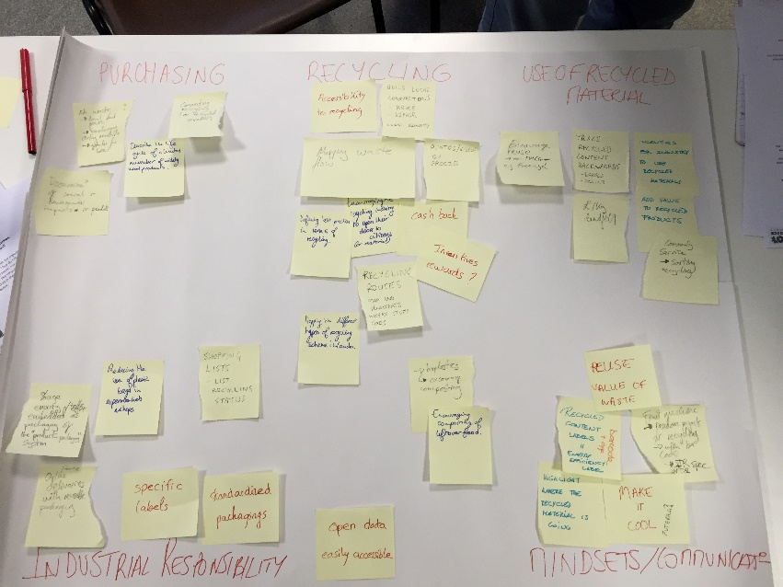
Putting ideas into the bin
RECYCLING
CHALLENGE
People’s mindset
Producing
(Industrial responsibility)
Purchasing choices
Recycling
Use of recycled material

Slide 4
Key inspiring data
RECYCLING
CHALLENGE
What is the level of information and trust in the waste management system?
Less than 70% of people know what items their local council collects for recycling.
Less than 25% of people know what happens to their recycling once it is picked up by the collection vehicle.
Less than 20% of people know the proportion of waste that their local council recycles.
What would motivate people to recycle more?
More than 70% of people would recycle more if they saved money on their council tax.
More than 70% of people would recycle more if their council collected a greater range of items.
Around 65% of people would recycle more if their local community benefited from recycling.
Source: The Ur[bin] Issue, Working with communities to improve urban recycling, http://www.sita.co.uk/downloads/TheUrbinIssueReport-1408-web.pdf

Slide 5
OSCE Days’ Challenge
RECYCLING
CHALLENGE
Goal: Encourage people to recycle more.
How? We would like to create a tool to:
Help people monitor their waste,
Provide them with more information on waste and the waste management system,
Create incentives and a sense of shared responsibility among neighbourhoods and boroughs.
This tool should:
Be easily accessible to everyone: an App,
Include a fun part to actually make people use it: competitive challenges,
Be implementable without the support of Borough Councils and the recycling industry (even if their support would make it even better).

Slide 6
The Recycling Challenge App
RECYCLING
CHALLENGE
Where is your waste going?
Is your neighbour-hood number 1?
UNDERSTAND
See your ranking!
Challenge yourself!
CHALLENGE
Great ideas? Show us!
Let’s meet!
SHARE
What can I recycle?
Weekly waste tips
RECYCLE
RECYCLING
CHALLENGE

Slide 7
The Recycling Challenge App – Overview

Slide 8
Ideas to go further
RECYCLING
CHALLENGE
Getting Recycling Officers (who are already working with London Councils to engage with local communities on recycling issues) to be ambassadors of the App, broadcast their activities and establish direct contacts with App Users.
Creating rewards for the best challengers (at individual or community level):
Vouchers in local shops
Financial reward financed by local authorities (i.e. cut in Council taxes)
Investigating to obtain information on waste and recycling volumes at neighbourhood and street levels to make the App more precise and create challenges between neighbourhoods or streets.
Engaging Councils to redistribute savings from lower landfill disposal in the neighbourhoods with highest recycling rate to make results of recycling tangible to people within their local community.
Creating a database that would allow customers to check the type of material used in each good they are buying and know immediately if it is recyclable locally.
Replicating the model worldwide!

