Slide 1
Open Source Circular Textiles Workshop
Partner: KHEPRW Institute
Indianapolis, IN
March 23rd, 2017

Slide 2
Agenda
Welcome and Introductions
Open Source Circular Economy – what is it and why should you be interested in it?
Open Source Circular Textiles – what are they, how are they useful to you and our local community?
Hands-on activities
Next workshop: June 2017

Slide 3
Open Source Circular Economy – What is it?
Open Source
is a successful collaboration method for developing
software, hardware and design. It is based on
transparent (and often distributed) development,
and the open sharing of files and solutions.

Slide 4
Open Source Circular Economy – What is it?
Circular Economy
is the concept of a truly sustainable economy that works
without waste, saves resources and is in synergy with the
biosphere. Rather than seeing emissions, byproducts, or
damaged and unwanted goods as ‘waste’, in the circular
economy they become raw material, nutrients for a new production cycle.

Slide 5
Open Source Circular Economy – What is it?
Open Source + Circular Economy
We believe that a sustainable, waste free,
circular economy needs transparency,
open access to information
and open source solutions.

Slide 6
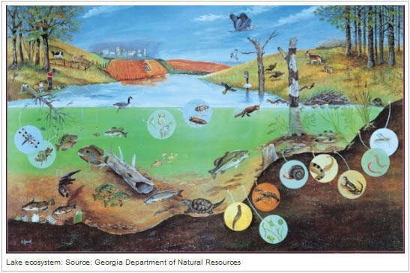
Open Source Circular Economy – What is it?

Slide 7
Natural nuclear fusion power plant
Virtually free, infinite
Renewable
Global impact
Earth’s Biogeochemical and Hydrological Cycles
Maintain
Reduce/Eliminate
Reuse
Increase/Maintain
Virgin
Renewable
Toxic
Non-toxic
Remanufacture
Socially bad
Non-virgin
Non-renewable
Socially good
Recycle
Energy/Material Flows
Energy/Material Flows
Nourish
C, H, N, O, P, S
Life’s Essential Elements
Minimize irreducible waste/leakage
Create feedstocks that do not disrupt Earth’s cycles
Notes:
All individual and business decisions and actions, no matter how small, lead to large aggregate impacts
Bring human life and activities in balance with Earth’s main cycles and finitude
Bring human-made world in balance with the natural world where diversity, resilience, redundancy, smallness, interdependence, waste-is-food, slowness are the keys to survive and thrive
There is no trash, no waste, no landfill in nature

Slide 8
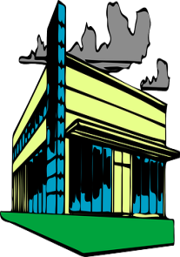
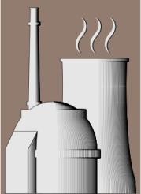
Local action
PRODUCT CIRCLES
BIO-BASED/NATURAL MATERIALS
TECHNICAL/SYNTHETIC MATERIALS
$
$
LOCAL SYMBIOSIS
Notes:
A solution to the wicked problems we have created in the last 300 years
A major opportunity for doing things differently with a positive impact on all 3 sustainability dimensions
Economic: good jobs, meaningful work, equity, fairness, dematerialize, renewable resources, local prosperity and resilience
Social: human rights, good life, health, no poverty, dignity, equal opportunity for all
Natural: eliminate waste and emissions, value biodiversity, don’t be “the most invasive species”
Operates on two planes
Product circles within flows of natural and technical materials between producers, servicers and users
Growth and disposal are replaced by circles of maintenance, long-lasting value and usage
Local symbiosis connects market and non-market stakeholders with the shared goal of prosperity and sustainability for all
In both planes, waste not acceptable
For every waste flow, feedstock demand is searched or created

Slide 9
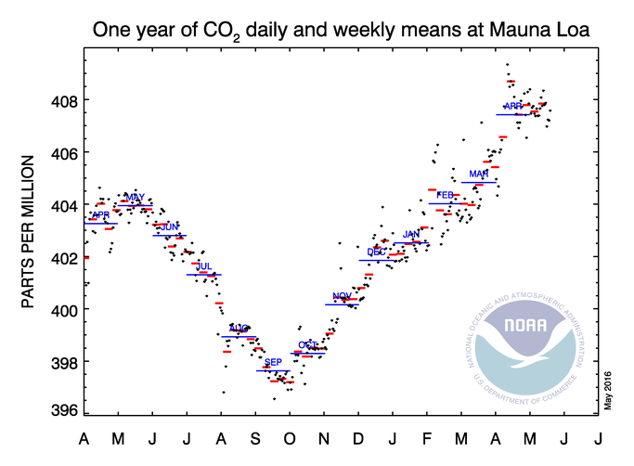
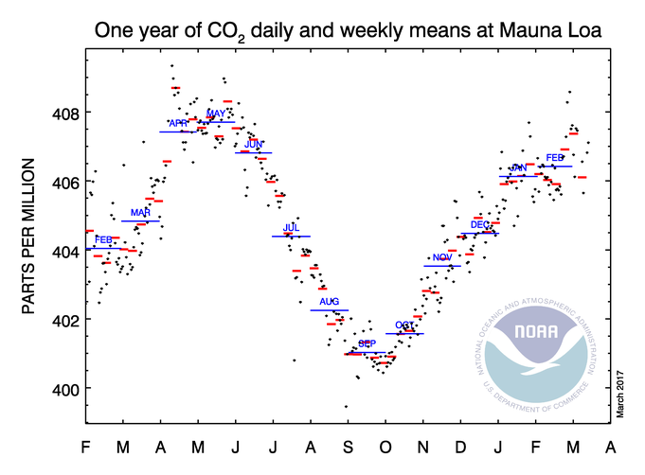
Open Source Circular Economy – Why should you care?
http://www.esrl.noaa.gov/gmd/ccgg/trends/weekly.html
Notes:
The change since our June 2016 OSCEdays event. Not good.
Note the re-scaling due to data points moving higher

Slide 10
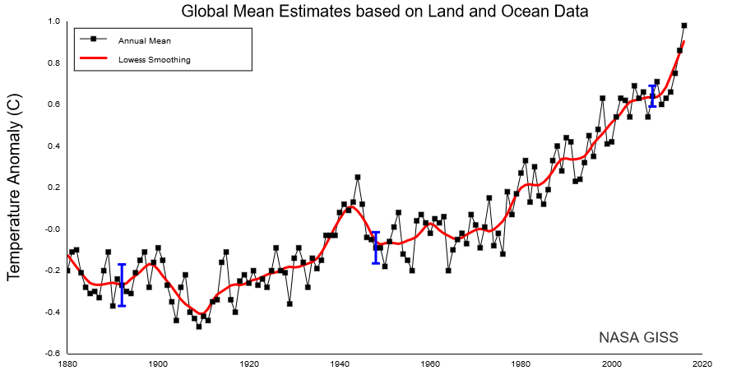
Open Source Circular Economy – Why should you care?
“Earth's 2016 surface temperatures were the warmest since modern recordkeeping began in 1880, according to independent analyses by NASA and the National Oceanic and Atmospheric Administration (NOAA).
Globally-averaged temperatures in 2016 were 1.78 degrees Fahrenheit (0.99 degrees Celsius) warmer than the mid-20th century mean. This makes 2016 the third year in a row to set a new record for global average surface temperatures.”
http://data.giss.nasa.gov/gistemp/maps/

Slide 11
Notes:
The hidden reality and costs of textile manufacturing
If you really need to buy a piece of clothing, whenever you check the label, before you look at the price, take a moment to think who made it, in what conditions, what are its impacts on the sustainability of your community and the planet

Slide 12
Open Source Circular Textiles – What are they?
Notes:
Textiles include a wide range of consumer and industrial products: from clothing to ship sails.
Textiles cover basic needs, but also a myriad of wants. Let’s focus on the basic needs and reduce the wants created by relentless marketing and status seeking.

Slide 13
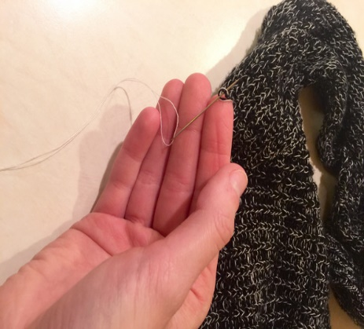
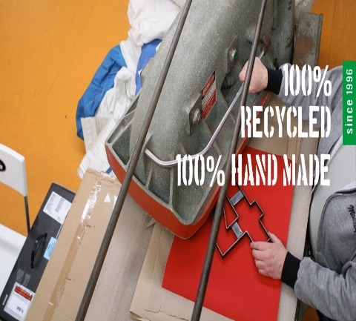
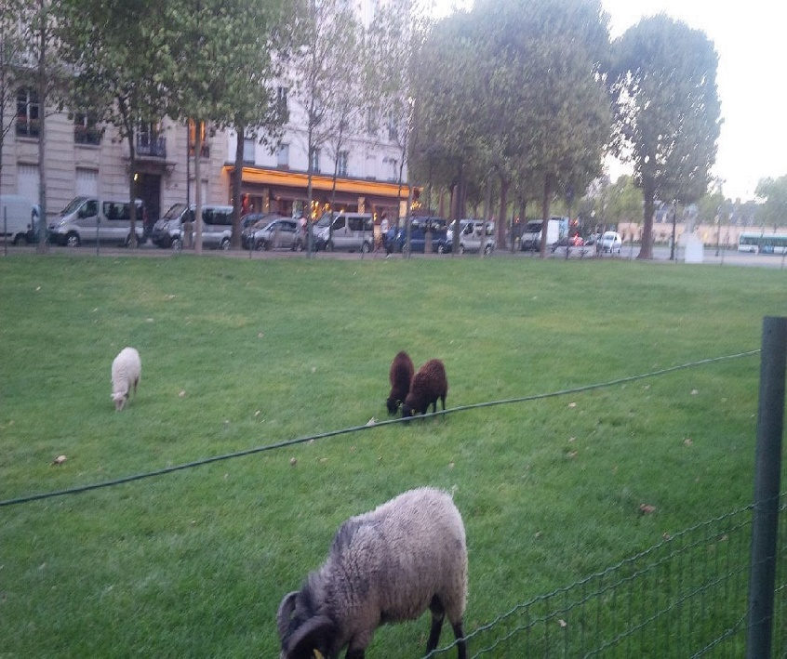
Open Source Circular Textiles – What are they?
Reuse
Re-Sails - repurposed sails
Maintain
Clothing repair - ifixit free manual
Remanufacture
Increase/Maintain
Renewable
Non-toxic
Recycle
Non-virgin
Socially good
Nourish
Energy/Material Flows
http://community.oscedays.org/t/public-wiki-circular-textiles/784
Notes:
A few examples of how the principles of open source circular economy apply to textiles

Slide 14
Open Source Circular Textiles – How are they useful to you and our local community
Save money
Make money
Create and maintain skills at every level, vocational and professional
Create and keep enterprises, social or commercial, local (e.g. repair is mostly non-tradable work)
Eliminate textile waste to landfill (the average US citizen sends 70 lbs/year to landfills)*
Create opportunities for innovation ( new materials, new uses for materials, rent instead of buy business model)
Eliminate chemical, air, water and other pollution ( non-fossil based materials, non-toxic dyes)
Inspire collaboration and solution sharing for fast, effective, positive impact
* http://www.weardonaterecycle.org/about/issue.html

Slide 15
Thank you! Next Workshop June 2017 What are your interests for the next workshop?
Join the Open Source Circular Economy Forum
http://community.oscedays.org/
Contact:
Silvia Leahu-Aluas silvia[at]sustainablemanufacturing.biz

