Slide 1
OSCEdays Girls eSTEAM Workshop
Partner: KHEPRW Institute
Tabitha Barbour
Silvia Leahu-Aluas
Indianapolis, IN
December 11th, 2017

Slide 2
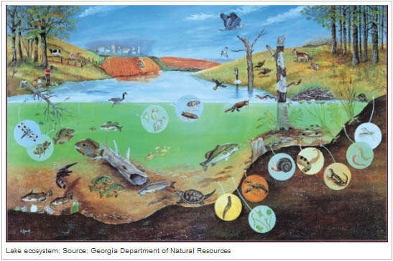
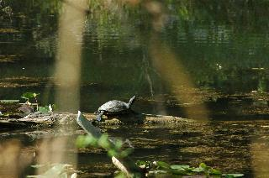
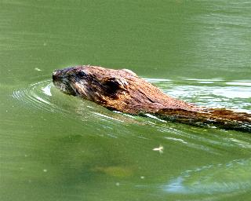
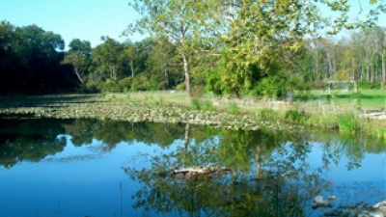
Open Source Circular Economy – An Ecosystem
https://www.marian.edu/about-marian/nina-mason-pulliam-ecolab

Slide 3
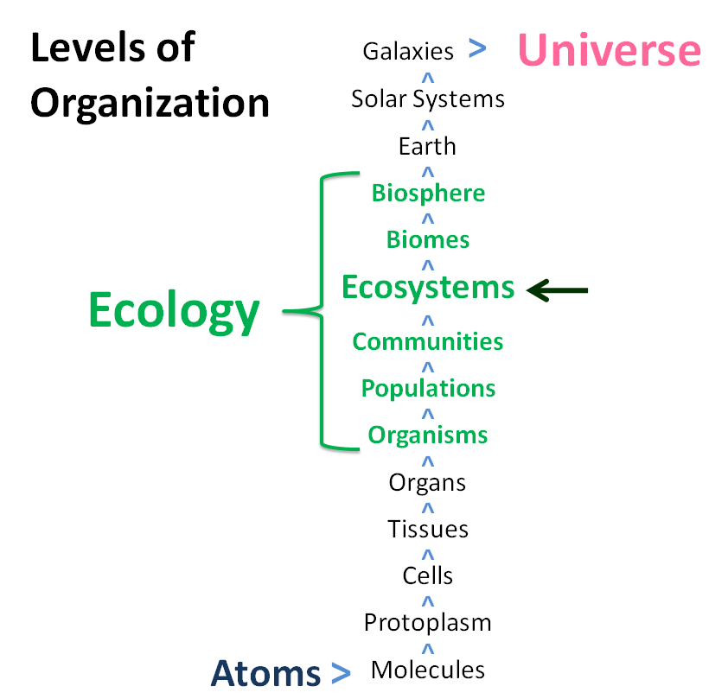
An ecosystem is a community of organisms interacting with each other and with their environment such that energy is exchanged and system-level processes, such as the cycling of elements, emerge.
Ecosystems include living organisms, the dead organic matter produced by them, the abiotic environment within which the organisms live and exchange elements (soils, water, atmosphere), and the interactions between these components. Ecosystems embody the concept that living organisms continually interact with each other and with the environment to produce complex systems with emergent properties, such that "the whole is greater than the sum of its parts" and "everything is connected".
http://www.eoearth.org/view/article/152248/

Slide 4
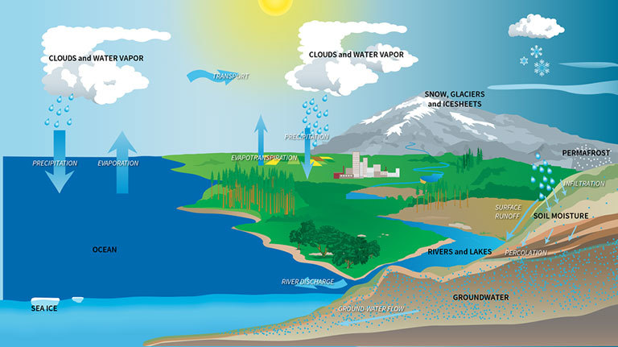
https://climate.nasa.gov/news/2307/satellites-track-earths-water-movements-to-help-complete-climate-picture/

Slide 5
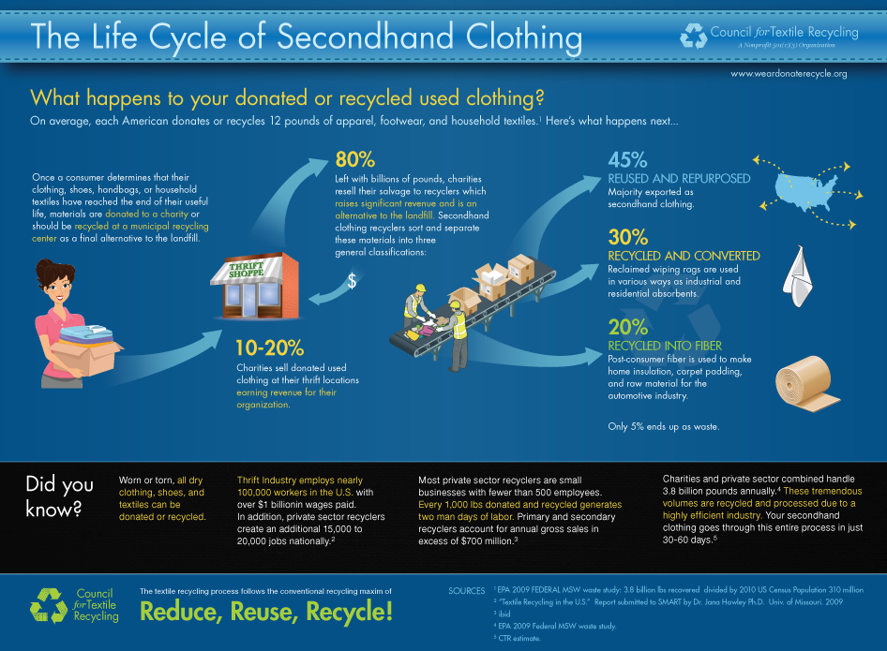
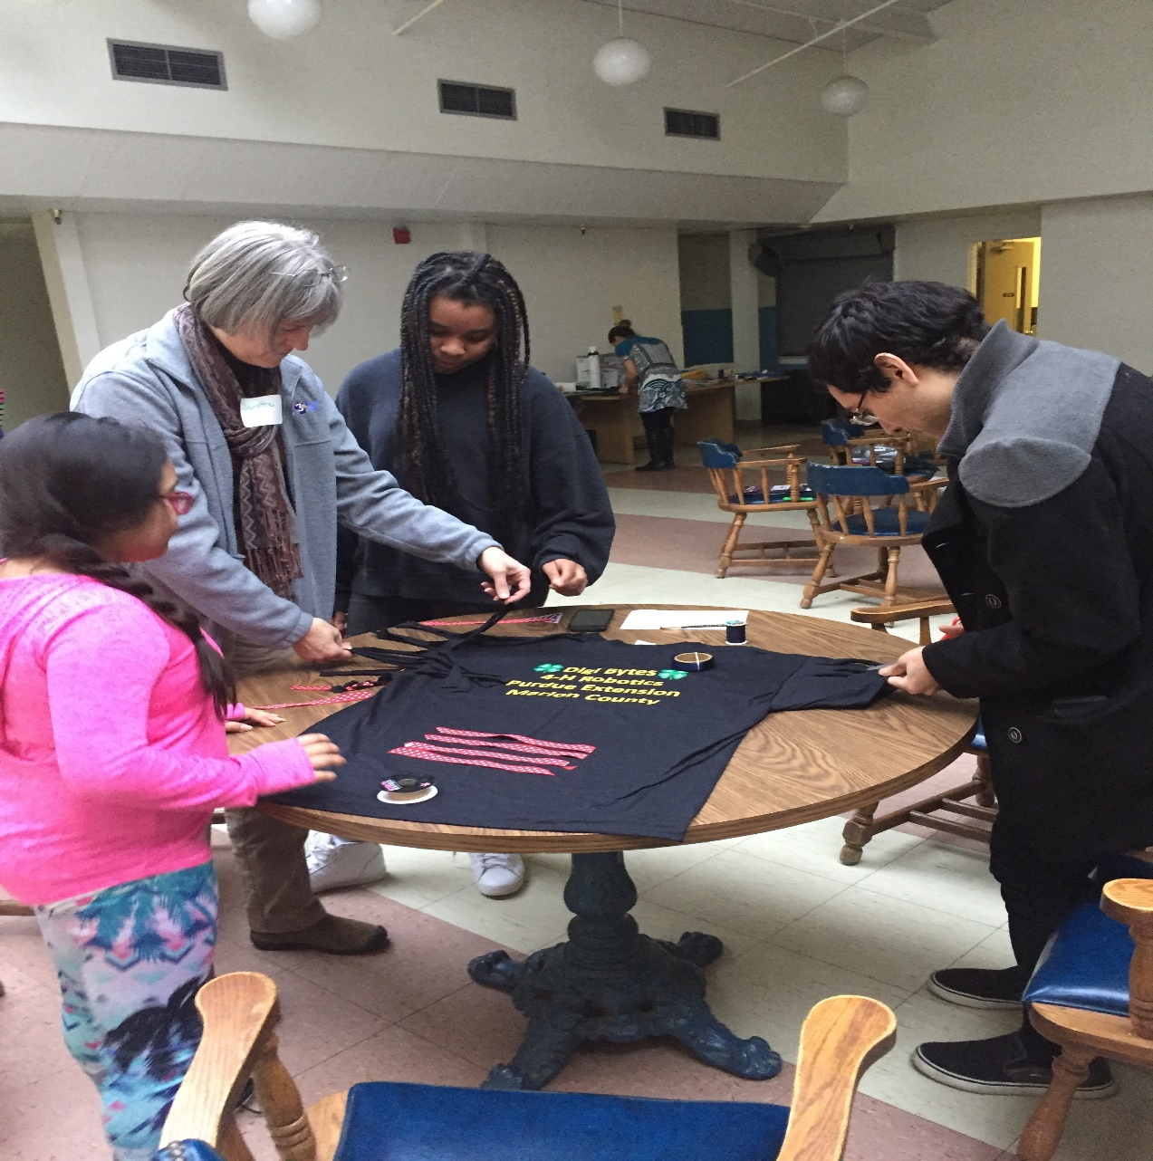
Open Source Circular Textiles – What are they?
https://vimeo.com/168325029
Notes:
Textiles include a wide range of consumer and industrial products: from clothing to ship sails.
Circular textiles are made from renewable resources, can be repaired, reused, recycled, used for a very long time. They are not polluting the land, water and air.
Textiles cover basic needs, but also a myriad of wants. Let’s focus on the basic needs and reduce the wants created by relentless marketing and status seeking.

Slide 6
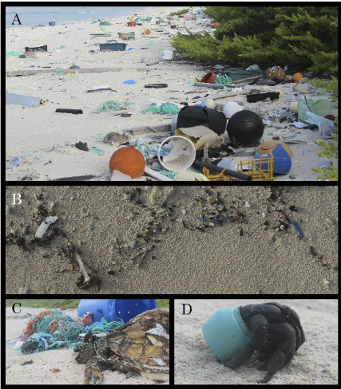
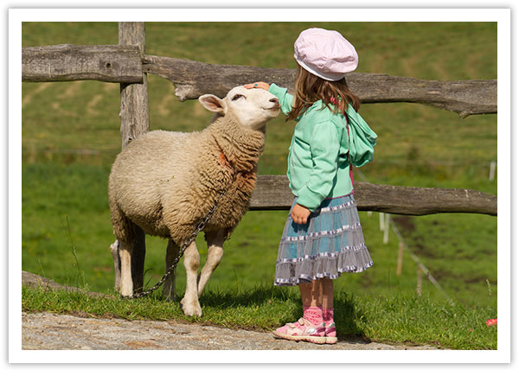
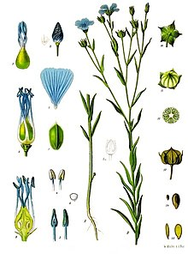
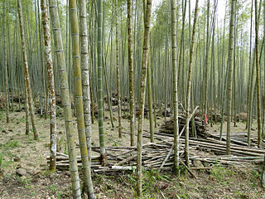
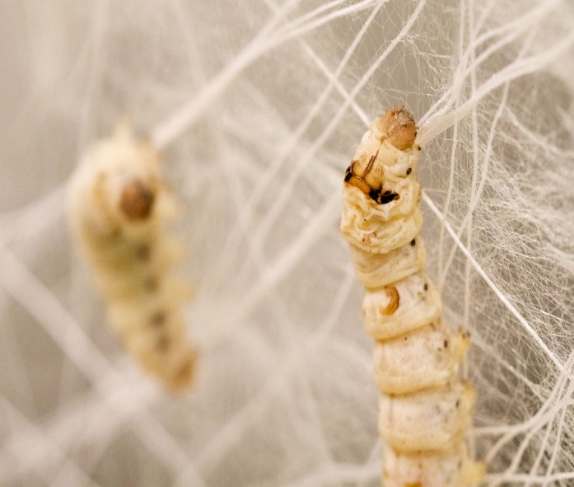
UNSUSTAINABLE AND SUSTAINABLE MATERIALS
http://www.pnas.org/content/114/23/6052.full.pdf
Notes:
Henderson Island, uninhabited island the South Pacific, 3100 miles away from any town or factory, highest density of debris reported anywhere in the world (“Exceptional and rapid accumulation of anthropogenic debris on one of the world’s most remote and pristine islands” by Jennifer L. Lavers and Alexander L. Bond, Proceedings of the National Academy of Sciences, June 6 2017)
“The 17.6 tons of anthropogenic debris estimated to be present on Henderson Island account for only 1.98 seconds’ worth of the annual global production of plastic”
Since the 1950s we have produced 8.3 billions tons of plastic and virtually all of it is somewhere on the planet, including human bodies
We are trashing the planet with plastic, destroying or endangering other species, but also ours, as we have started drinking/breathing micro plastics

Slide 7
MAKING SUSTAINABLE MATERIALS WHILE SAVING THE MONARCH BUTTERFLY

Slide 8
Thank you! Let’s make a tote bag…
Join the Open Source Circular Economy Forum
http://community.oscedays.org/

