Slide 1
Introducing Open Hack to SRG Philosophy of Rapid Whole System Change
Openhac-srg-rev3.ppt
Feb 27, 2018
Notes:
G: Hi everyone, my name is Gien and I’m a co-founder of Stop Reset Go, a global citizen’s collective focused on citizen-driven strategies that empower rapid whole system change.
T: And I’m Tsholo Monares, a television producer, filmmaker and Sangoma, a citizen change agent working with SRG and … G: Stop Reset Go is also a simple 3 step procedure that can be applied anywhere and at any scale to transform a situation of harm to a situation of holistic wellbeing.

Slide 2
A simple 3 step process for transforming harm to wellbeing
Stop
harm
Find and test
viable alternatives
Implement the best solution
1
Notes:
G: Hi everyone, my name is Gien and I’m a co-founder of Stop Reset Go, a global citizen’s collective focused on citizen-driven strategies that empower rapid whole system change.
T: And I’m Tsholo Monares, a television producer, filmmaker and Sangoma, a citizen change agent working with SRG and … G: Stop Reset Go is also a simple 3 step procedure that can be applied anywhere and at any scale to transform a situation of harm to a situation of holistic wellbeing.

Slide 3
GAMIFYING SRG
CAMPAIGN | STOP | RESET | GO
Government Corruption | Identified corruption problem
Food Security | Monoculture expensive and vulnerable to climate change | Agroforestry? Perform a pilot study
Water Security | Stop water shortage | Test a new type of low cost solar still | Works great. Now setting up local manufaturing
Gang Violence | Stop the cycle from prison to streets | Yoga program and educate Deep Humanity | Try pilot in Poolsnoor maxium security prison
2

Slide 4
Citizen-Driven, Rapid Whole System Change
Deep Humanity
Human Interior Transformation
A Complementary Strategy
for
Cosmo-Localization
Social Exterior Transformation
The heart feels,
the mind thinks,
and the body acts.
3
Notes:
T: As cognitive self-conscious beings, we all perform three steps that result in impacts in our collective world…our mind thinks, our heart feels and our body follows through and acts in the world out here.
G: We have evolved a citizen strategy based upon this internal, external duality of our human nature. We have found there is a need for both interior and exterior transformation.

Slide 5
COSMO
Global
Design
Knowledge
Commons
The Body Acts
LOCALIZATION
Downloading
Designs for
Local, Circular Peer Production
Cosmo-Localization
Social Exterior Transformation
4

Slide 6
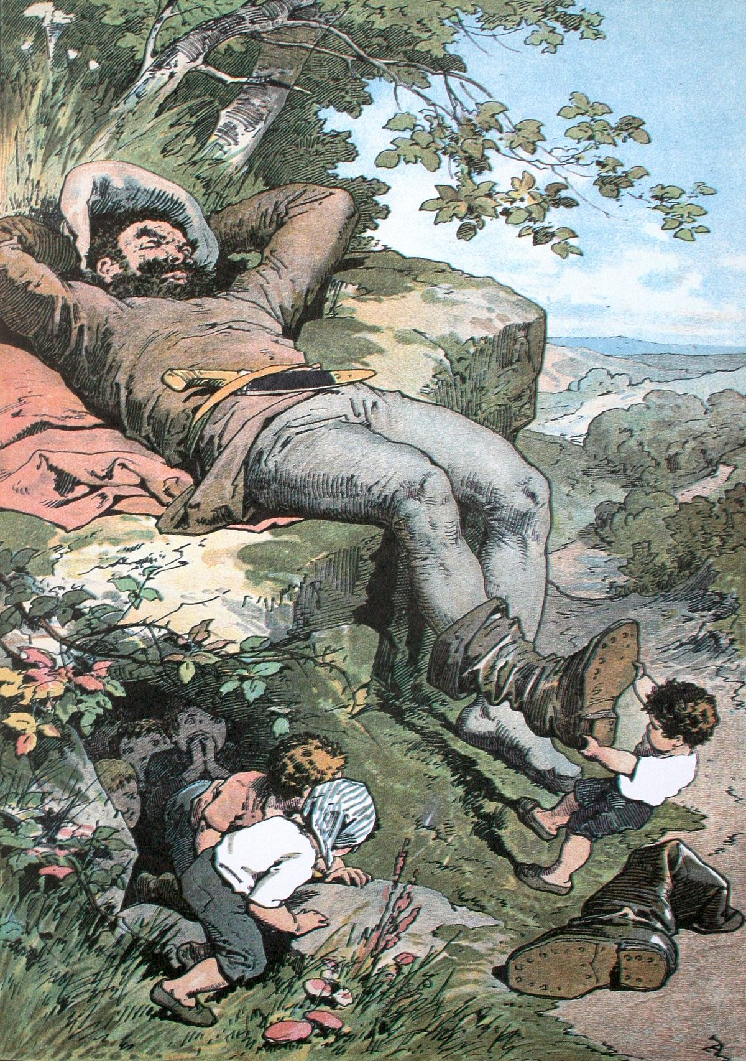
Awakening the Sleeping Giant
Real change occurs from the bottom up; it occurs person to person, and it almost always occurs in small groups and locales and then bubbles up and aggregates to larger vectors of change.
- Paul Hawken
Never doubt that a small group of thoughtful, committed citizens can change the world; indeed, it's the only thing that ever has.
- Margaret Mead
5

Slide 7
Potential for Peer Production
3D Printing: A Threat to Global Trade
Locally printed goods can cut trade by 40%
Sept 28, 2017
6

Slide 8
DEFINITIONS
ECONOMY
ROI
MEconomy
WEconomy
ROCI
RORI
Competition
Collaboration
Return on
Capital Investment
Return on
Resource Investment
7
Notes:
Give example of home vs outside of home

Slide 9
ECONOMIC
JUSTIFICATION
May 7, 2017 Rev 1.0
8

Slide 10
CURRENT ECONOMIC INVESTMENT MODEL
5
SUCCESSFUL
PRODUCTION
4
EXCHANGE CAPITAL FOR HUMAN, LAND, TECHNOLOGY RESOURCES
6a
INVESTORS MAKE RETURN ON CAPITAL INVESTMENT
R O C I
6b
COMPANY BECOMES PART OF MECONOMY
MECONOMIC LOCKIN (FAUSTIAN DEAL):
INNOVATOR SECURES CAPITAL IN EXCHANGE FOR SHARES.
SHAREHOLDERS REQUIRE MIN. SALES VOLUME & PRICING TO RECOVER INVESTMENT AND MAKE PROFIT
INNOVATOR NOW LOCKED INTO MECONOMY: SALES AT SUFFICIENTLY HIGH PRICE TO RECOVER CAPITAL AND RETURN PROFITS TO SHAREHOLDERS
LOCKIN INSURES INNOVATORS ARE NOW LOCKED IN MECONOMIC SYSTEM – RESULTING IN THE DENIAL OF PRODUCT OR SERVICE ACCESSIBILITY TO PEOPLE WITHOUT THE CAPITAL TO AFFORD IT, CONTRIBUTING TO SYSTEMIC INEQUALITY
CREATES MONOPOLY CONTROL
MAKES PRODUCTION & PRODUCTS INACCESSIBLE
CREATES COMPETITION SILOS WITH REDUNDANCY
CREATES INEQUALITY
3
SECURE CAPITAL INVESTORS
(MEconomic Lockin)
1
NEW IDEA
HUMAN
CAPITAL
2
REQUIRE RESOURCES BUT NEED CAPITAL PROXY TO SECURE RESOURCES
IDEA
FINANCIAL
CAPITAL
NORMAL INVESTMENT FLOW
9

Slide 11
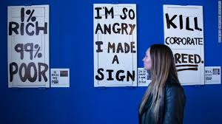
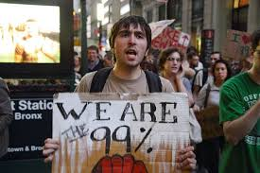
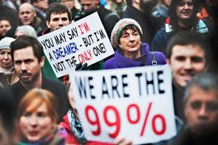
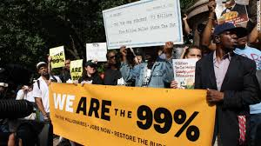
The Language of the 99%
10

Slide 12
WHERE IS THE STRENGTH OF THE 99%?
 | 1 % | 99% (COMMONS)
STRENGTHS | Financial capital | Human capital
WEAKNESSES | Human capital | Financial capital
 | INVESTMENT STRATEGY | LEVERAGING | COMMONS
Traditional | Go to 1% | Financial capital | Weakness
Crowdfunding | Go to everyone | Financial capital | Weakness
WEconomy | Go to 99% | Human capital | Strength
Massive Open Online Citizens Collaboration (MOOCC)
11

Slide 13
CREATING AN OPEN DESIGN KNOWLEDGE COMMONS
12

Slide 14
MOOCC is DISRUPTIVE
HUMAN CAPITAL
MOOCC
BYPASS FINANCIAL CAPITAL
FINANCIAL CAPITAL
INNOVATION
CURRENT MEconomy FLOW
NEW WEconomy FLOW
13

Slide 15
1. THE ALTRUIST’S DILEMMA: LIVING IN THE COMPETITIVE MEconomy
2. IMPROVING THE ODDS: CREATE LOCAL CLUSTERS OF LIKE-MINDED CHANGE AGENTS
3. COSMO-LOCALIZATION: LINK TOGETHER CLUSTERS TO CREATE A GLOBAL INNOVATION WEconomy
4. COSMO-LOCALIZATION: DOWNLOADING DESIGNS FOR PEER PRODUCTION WEconomy
14

Slide 16
EXAMPLE RORI OF MOOCC: 1000 HUBS
No individual commons community has enough idle capacity to design all the goods and services required to build and operate a prosperous community. We can only do that through accessing planetary scale idling capacity. Engage a participatory democracy approach that leverages idling innovation capacity of the commons to bootstrap a WEconomy into existence. Each local innovation community is a cooperative organization governed by participatory governance. Each innovation community contributes open source circular designs to a common design pool AND has access to any of the designs. Each community abides by a constitution designed around principles of Deep Humanity.
UPLOAD – X designs into commons design repository
DOWNLOAD – XN designs from commons design repository to build local economy
IPPC
1
RORI
= 10,000/10
= 1,000
10 / annum
9,990
10, 000 DESIGNS / ANNUM
IPPC
2
10 / annum
RORI
= 10,000/10
= 1,000
9,990
…
9,990
RORI
= 10,000/10
= 1,000
IPPC 1000
10 / annum
KEY
IPPC - INNOVATION & PEER PRODUCTION COMMUNITY
15

Slide 17
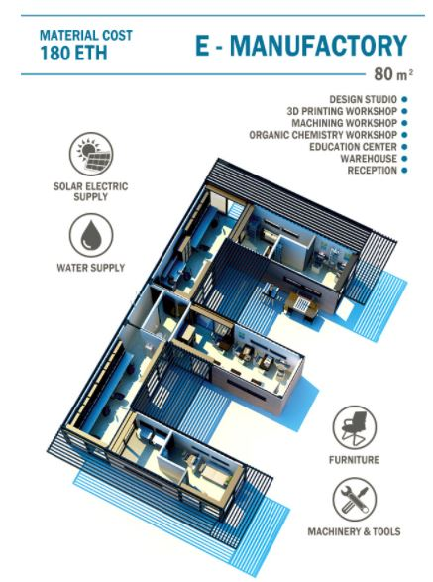
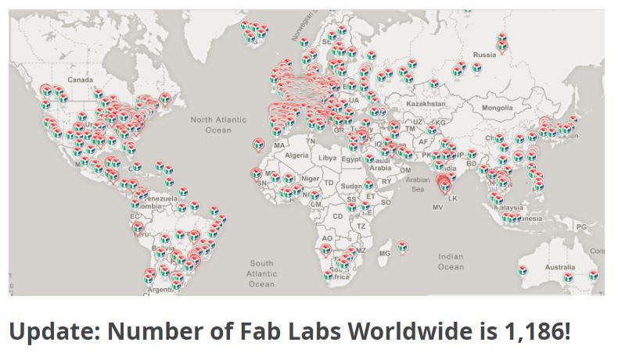
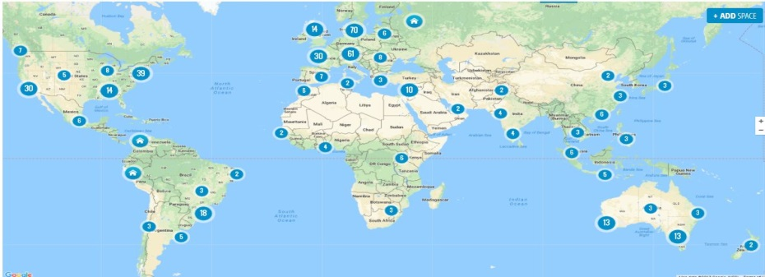
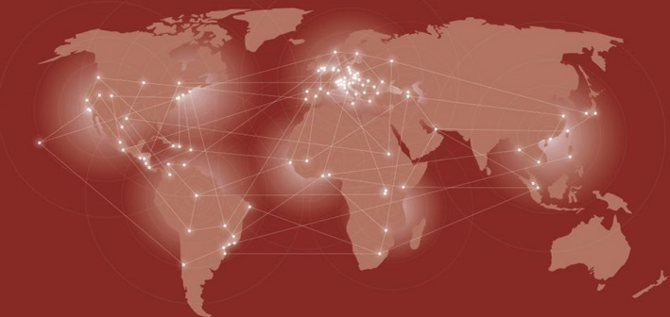
HOW REALISTIC IS 1,000 INNOVATION PEER PRODUCTION NODES?
Approx. 200
Approx.
400
Approx. 2200
SUPERHERO SPACE GLOBAL ACCELERATOR HUBS: 231
Approx. 86
16

Slide 18
Individual Hub Member RORI
KEY:
Produced within local WEconomy
Cost
Produced within MEconomy
Year 5
Individual’s Living Resource Requirements
Food Energy Housing Car Flights Computer Internet Health etc…
MEconomy Decoupling
Access goods and services from solidarity cooperative at cost
Surplus sold to MEconomy
Cost
Year 3
Individual’s Living Resource Requirements
Food Energy Housing Car Flights Computer Internet Health etc…
Cost
Year 1
Individual’s Living Resource Requirements
Food Energy Housing Car Flights Computer Internet Health etc…
17

Slide 19
WEconomy UPWARD RESOURCE INVESTMENT SPIRAL
HUMAN CAPITAL
BYPASS
FINANCIAL
CAPITAL
YEAR M
4. INVESTOR RROI
1. NEW IDEAS
IDEA
FINANCIAL CAPITAL
SRG RESOURCE ACQUISITION FLOW
YEAR 5
4. INVESTOR RROI
3. SUCCESSFUL PRODUCTION
1. NEW IDEAS
2. SECURE RESOURCE INVESTORS
YEAR 3
4. INVESTOR RROI
3. SUCCESSFUL PRODUCTION
2. SECURE RESOURCE INVESTORS
1. NEW IDEAS
YEAR 1
3. SUCCESSFUL PRODUCTION
4. INVESTOR RROI
2. SECURE RESOURCE INVESTORS
1. NEW IDEAS
PROCESS
With enough idling resource, there is no need for large amounts of capital:
Investor resource living expense is decreased as each receives more internal WEconomic dividends.
Capital living expenses also decrease because there is proportional decrease in demand for goods & services outside the WEconomy
Also receive capital from surplus sales into MEconomy to purchase what WEconomiy can’t produce.
RESOURCE PARTICIPANTS / INVESTORS
Have idling capacity - invest time & other resources
Contribute valuable skills
Investors ARE the resource and helps bypass the need for capital
18

Slide 20
QUALITATIVE PROFIT TRENDS OF Weconomic
INNOVATION / PEER PRODUCTION COMMUNITY
WEconomy
PRODUCTION
OUTPUT
PARTICIPANT / RESOURCE INVESTOR
RESOURCE
LIVING EXPENSE
PARTICIPANT / RESOURCE INVESTOR
CAPITAL
LIVING EXPENSE
PROFIT FROM
SURPLUS SALES INTO MEconomy
YEAR M
YEAR 5
YEAR 3
YEAR 1
19

Slide 21
POTENTIAL INNOVATION / PRODUCTION COOPERATIVE EARNING FORMULA
ORIGINALITY OF IDEA
TIME SPENT
QUALITY OF WORK
IMPACT OF GOODS or SERVICES
TIER 4
TIER 3
TIER 2
TIER 1
19

Slide 22
ECOLOGICAL
JUSTIFICATION
20

Slide 23
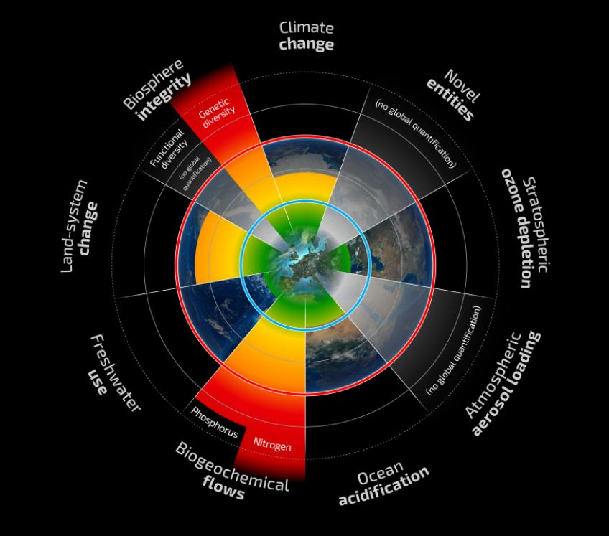
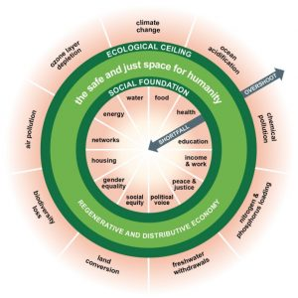
21

Slide 24
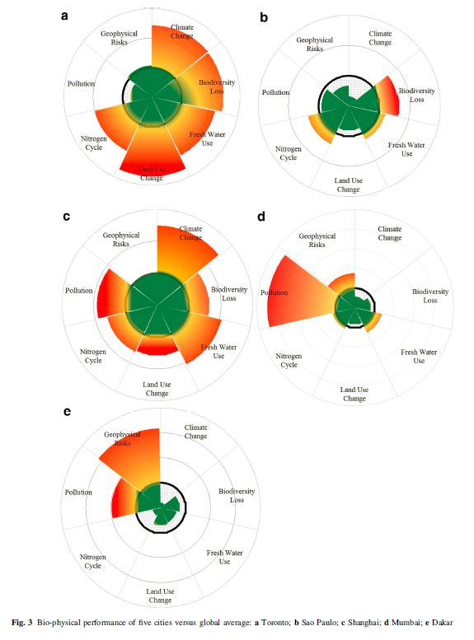
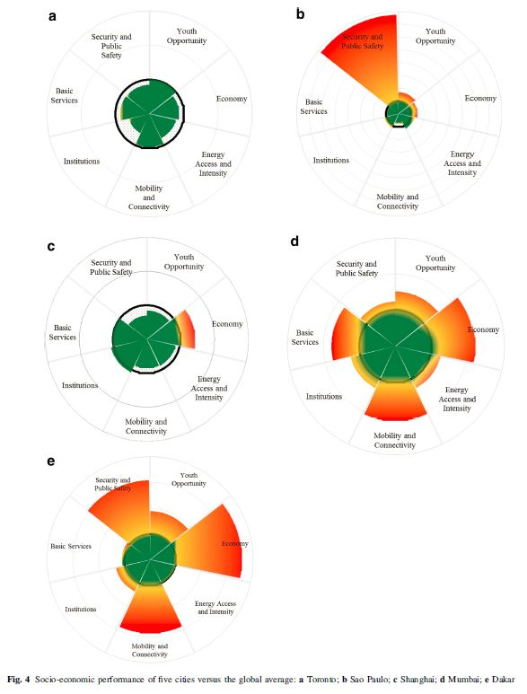
Urban Planetary Boundaries
a. Toronto, b. SaoPaulo, c. Shanghai, d. Mumbai, e. Dakar
Biophysical
Socio-economic
(Reference: Hoornweg, 2016)
22

Slide 25
HOORNWEG’S URBAN PLANETARY BOUNDARIES
BIOPHYSICAL INDICATORS
Climate Change
Biodiversity Loss
Land Use Change
Nitrogen Cycle
Pollution
Geophysical Risk
Fresh Water Use
SOCIO-ECONOMIC INDICATORS
Economy
Basic Services
Energy Access and Intensity
Mobility and Connectivity
Institutions
Youth Opportunity
Security and Public Safety
23

Slide 26
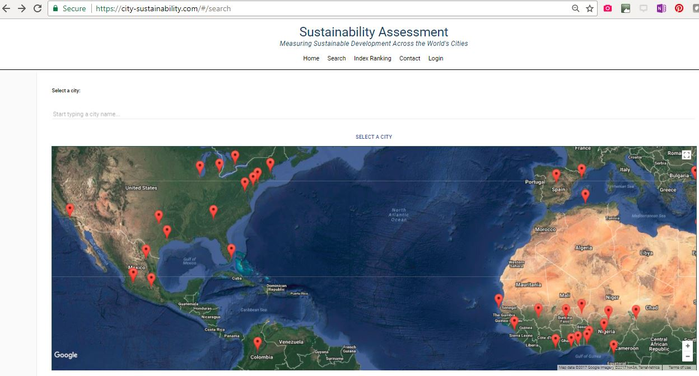
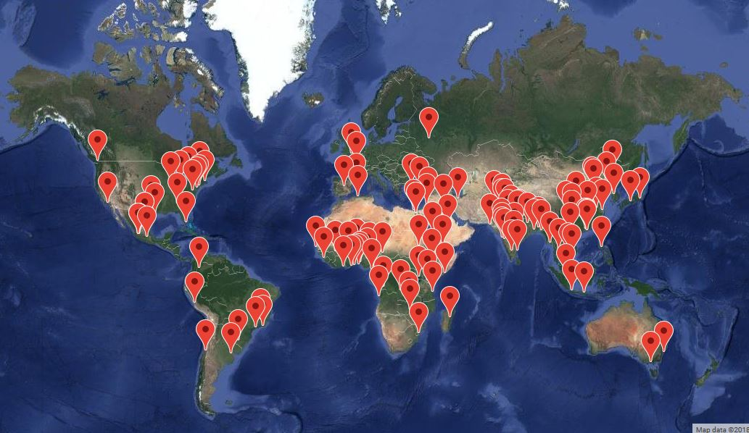
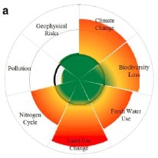
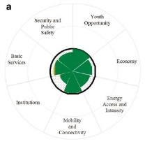
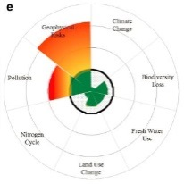
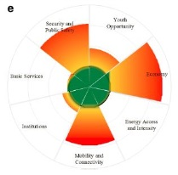
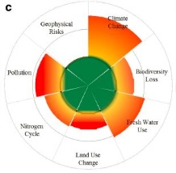
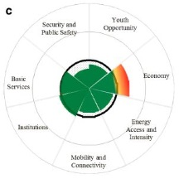
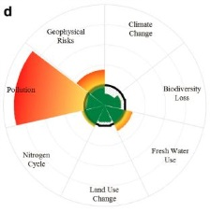
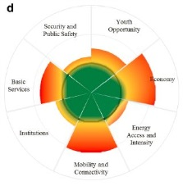
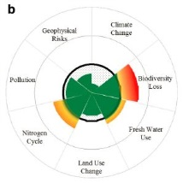
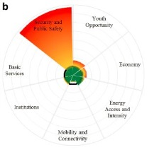
INDUSTRIALIZED
CITIES
NON
INDUSTRIALIZED
CITIES
(Hoornweg, 2016)
24

Slide 27
CONCLUSION: WE ARE VIOLATING DOUGHNUT ECONOMICS
… ALMOST EVERYWHERE
X
(Raworth, 2012)
25

Slide 28
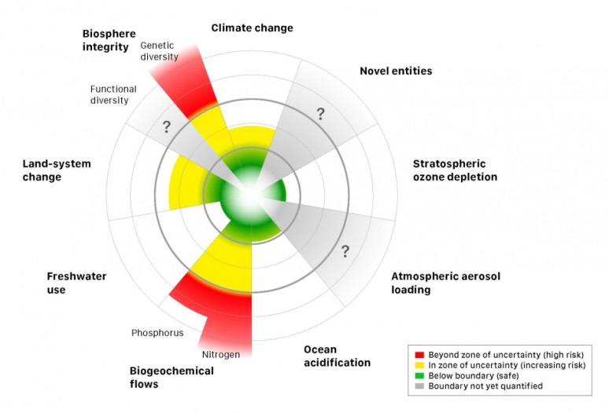
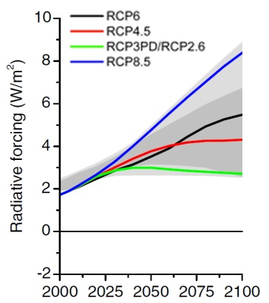
GAMIFICATION: GLOBAL “BENDING THE CURVE”
CLIMATE CHANGE
A
B
Figure: A) GLOBAL PLANETARY BOUNDARY (Rockstrom et al, 2009)
B) Global Radiative Forcing of the Representative Concentration Pathways. From van Vuuren et al (2011) The Representative Concentration Pathways: An Overview. Climatic Change, 109 (1-2), 5-31. . The light grey area captures 98% of the range in previous IAM scenarios, and dark grey represents 90% of the range.
26

Slide 29
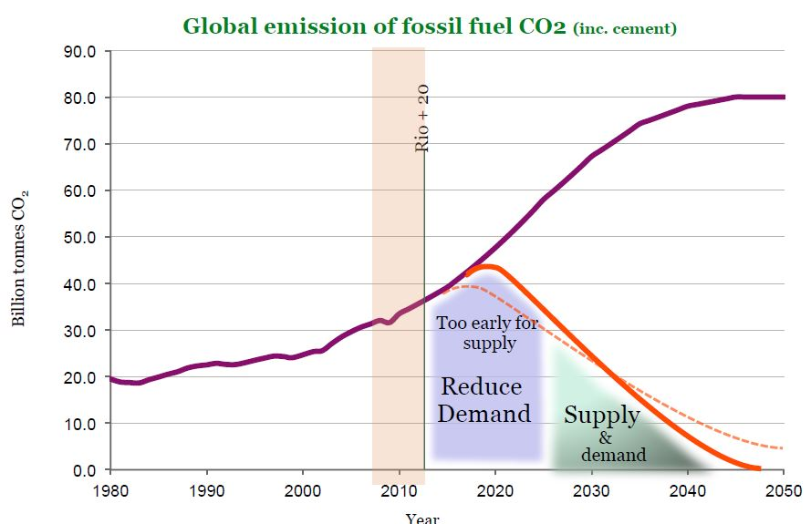
TRENDS CAN HAVE VERY UNIQUE CHARACTERISTICS
EXAMPLE: GLOBAL WARMING FOCUS AREAS
FOCUS ON DEMAND SIDE REDUCTION
(Anderson, 2014)
25

Slide 30
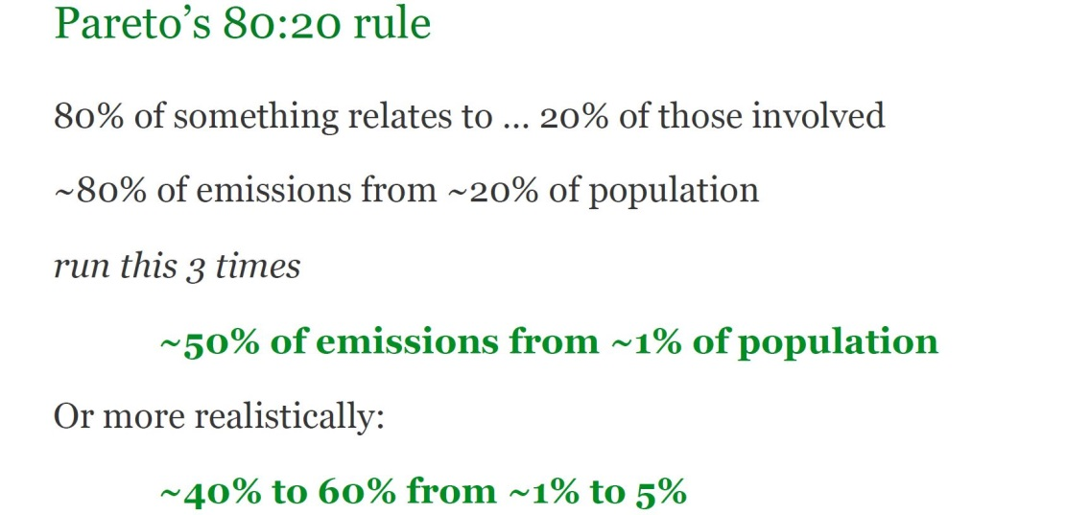
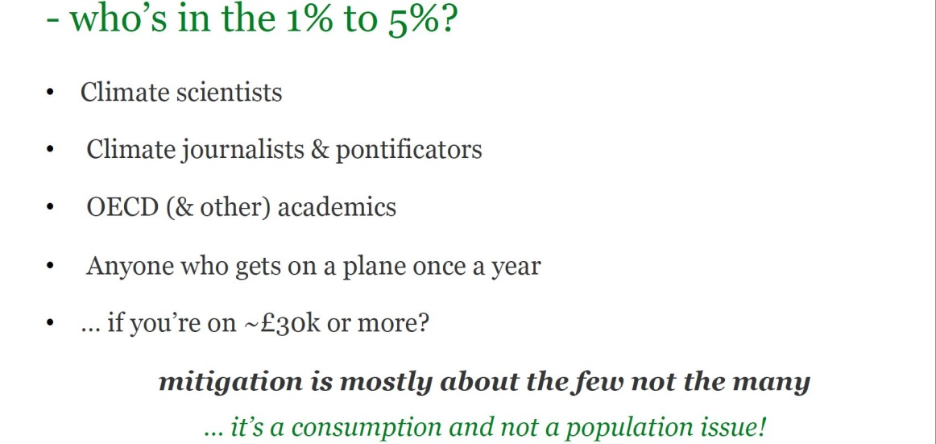
TRENDS CAN HAVE VERY UNIQUE CHARACTERISTICS
EXAMPLE: GLOBAL WARMING FOCUS AREAS
FOCUS ON THE AFFLUENT
(Anderson, 2014)
25

Slide 31
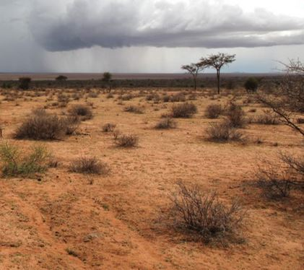
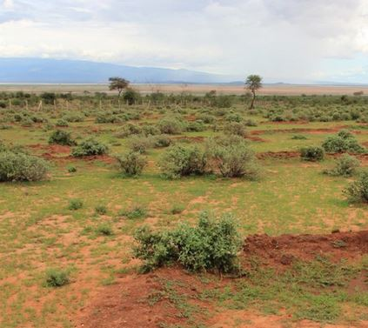
TRENDS CAN HAVE VERY UNIQUE CHARACTERISTICS
EXAMPLE: GLOBAL WARMING FOCUS AREAS
FOCUS ON RESTORING THE WATER CYCLE
(Justdiggit, 2015)
25

Slide 32
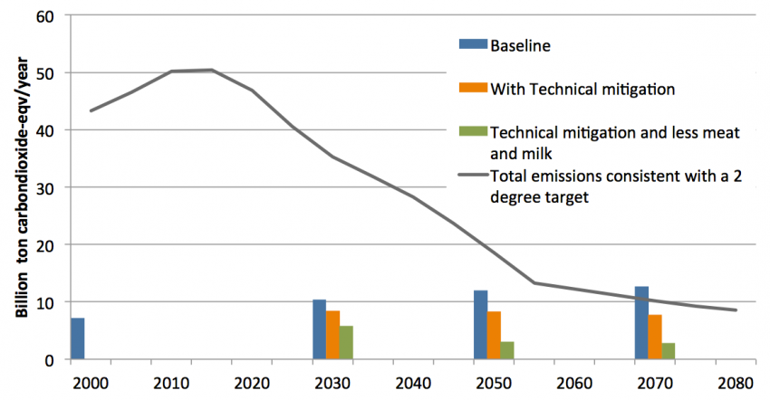
TRENDS CAN HAVE VERY UNIQUE CHARACTERISTICS
EXAMPLE: GLOBAL WARMING FOCUS AREAS
REDUCTION IN MEAT & DAIRY
Agricultural Emissions
(Hedenus et al, 2014)
25

Slide 33
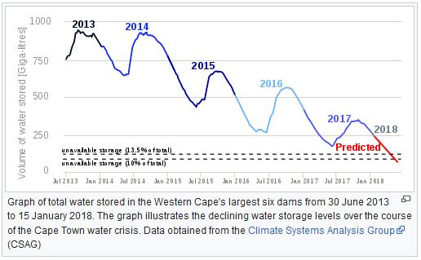
GAMIFICATION: REGIONAL “BENDING THE CURVE”
CAPE TOWN - FRESHWATER
GLOBAL PLANETARY BOUNDARIES
URBAN & REGIONAL PLANETARY BOUNDARIES
SINGLE BOUNDARY:
FRESH WATER
27

Slide 34
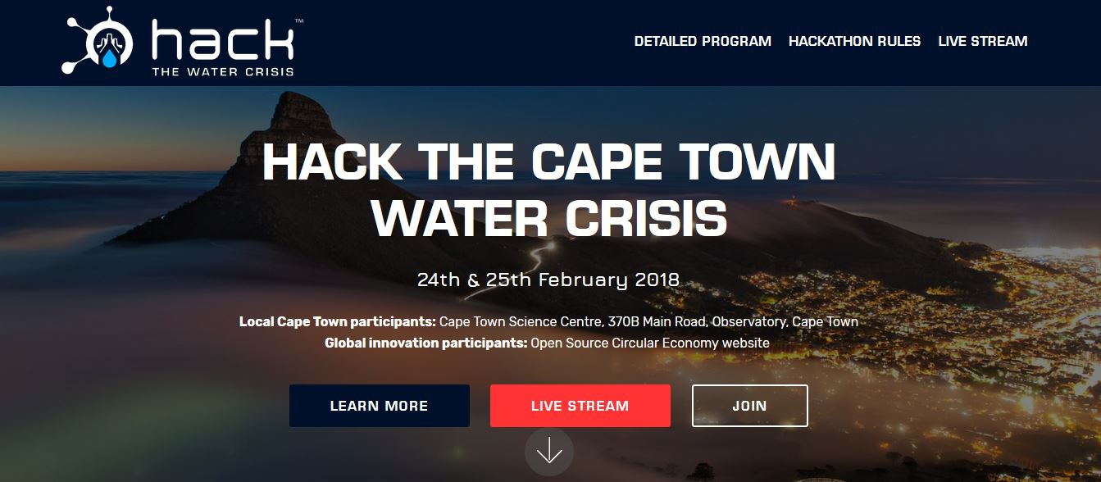
Hack the Cape Town Water Crisis
Information Page
28

Slide 35
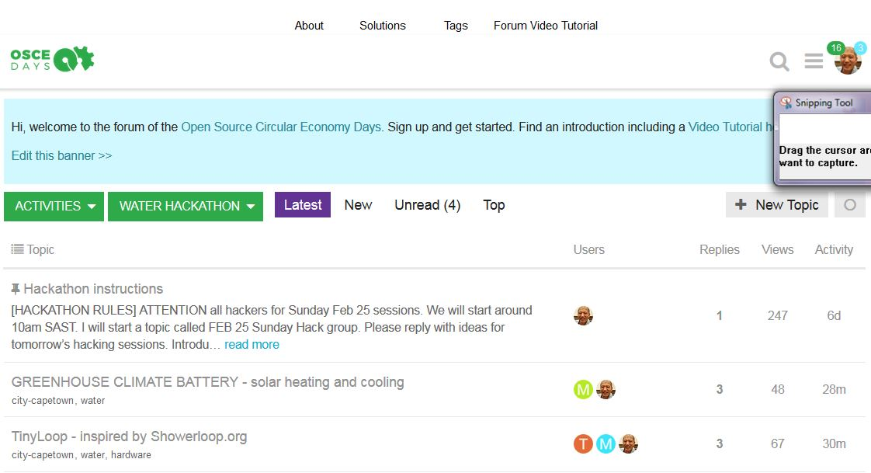
Hack the Cape Town Water Crisis
Hack Pages
29

Slide 36
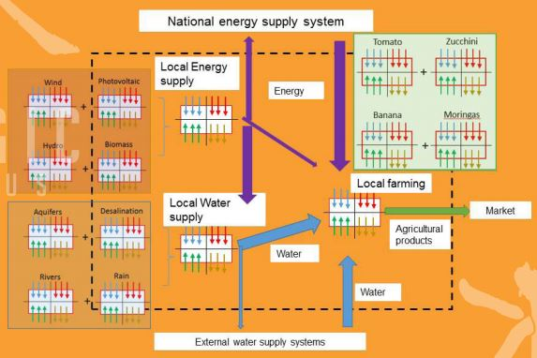
Social Ecological Systems require a Nexus analysis (Water-energy-food)
Example: Desalinating sea water for agriculture using wind energy in Gran Canaria
(Magic-Nexus Program, EU)
30

Slide 37
Why not Gamify ALL boundaries for ALL city on the Globe?
“Bend the Curve” to save civilization!
UPB
UPB
UPB
URB
URB
URB
SAFE
SAFE
SAFE
UPB
URB
UPB
UPB
URB
URB
SAFE
SAFE
SAFE
UPB
URB
UPB
UPB
URB
UPB
URB
SAFE
UPB
SAFE
URB
SAFE
URB
UPB
URB
SAFE
SAFE
SAFE
TORONTO, CANADA
BIOPHYSICAL
MUMBAI, INDIA
SOCIO-ECONOMIC
31

Slide 38
MANY FUTURE HACKATHONS
TRULY HACKING FOR HUMANITY!
SELECT THE CITY IN CRISIS
SELECT THE CRISIS INDICATOR(S) or SUBINDICATOR(S)
EACH CITY HAS ITS OWN UNIQUE PERMUTATION OF PROBLEMS DETERMINED BY URBAN & REGIONAL BOUNDARIES AND REALTIME TRENDS
HACKING ALL CITIES SIMULTANEOUSLY, WE CAN AGGREGATE IMPACTS FOR ALL CITY TO “BEND THE CURVE” FOR HUMANITY
GLOBAL IMPACT = ∑ REGIONAL IMPACTS
32

Slide 39
Urban Footprint Scenario Planning S/W
33

Slide 40
Scaling Solutions across the City using Urban Footprint
And across the planet
TGI= ∑ I_{CiSjIk}
m,n,o
i,j,k = 1,1,1
TGI = TOTAL GLOBAL IMPACT
i CITY
J SOLUTIONS
k INDICATORS
34

Slide 41
Gamifying Transition: A MOOCC Platform Cooperativism to Bend the Curve
6. Compare urban impact of aggregate solutions of one trend to threshold. Use feedback to bend the regional curve.
7. Compare all regional boundaries & apply MuSIASEM to account for feedbacks.
1. Gather open data to create realtime trends and thresholds
OPEN DATABASES
UPB
URBAN
PLANETARY BOUNDARIES
URBAN
REGIONAL BOUNDARIES
URB
. . .
SAFE
10. Totalize impacts across all urban regions to bend the planetary curve
REALTIME TRENDS
8. Progress Trap analysis
9. Implement regional solution
URBAN FOOTPRINT SCENARIO PLANNING S/W
MuSIASEM
Progress
Traps
RESOURCES
5. Aggregate and measure all impacts across entire urban area
INNOVATION IDEA GRAPH DATABASE
3. Seed innovation
BLOCKCHAIN
ENGINE
4. Track and Compensate
impactful innovations
SOCIAL NETWORK GRAPH DATABASE
2. Gather innovators
35

Slide 42
Blockchain Compensation “Karma”
Poorest
Compensation
Highest
Compensation
Moderate
Compensation
Compensation tracks greatest network impact of the solution.
36

Slide 43
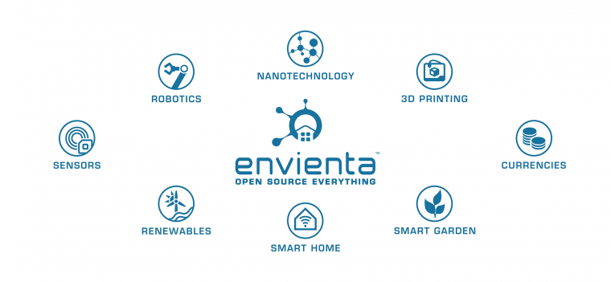
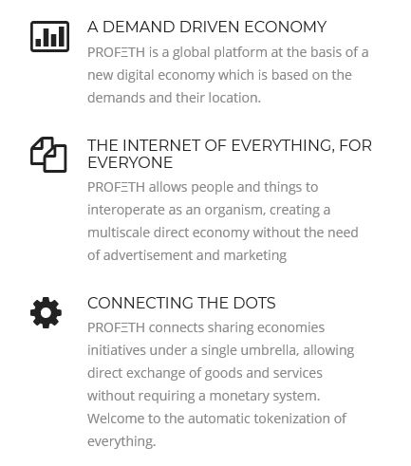
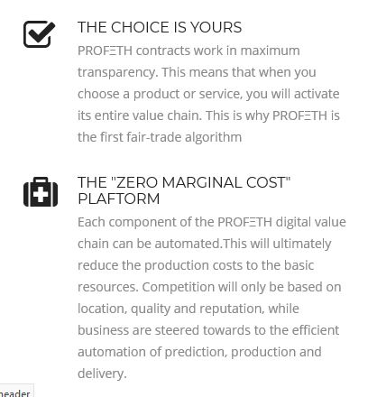
Tools and Partners
37

Slide 44
Thank You!
https://stopresetgo.org
www.hackthewatercrisis.org
https://oscedays.org
gien@stopresetgo.org
38

