Slide 1
Generating Value By Opening Up:
A Step-by-Step Practical Guide
Open Source Business Models
NOVEMBER 22, 2017 | DIF Festival
Seigo Robinson
@seigorobinson
socialcirculareconomy.com
Lars Zimmermann
@bricktick
larszimmermann.de

Slide 2
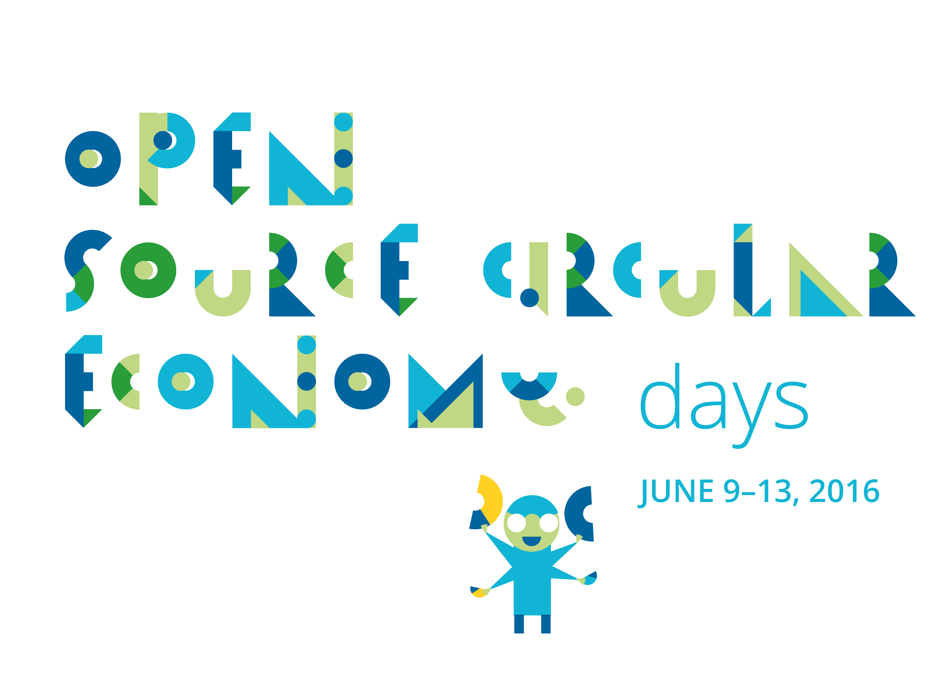
oscedays.org

Slide 3
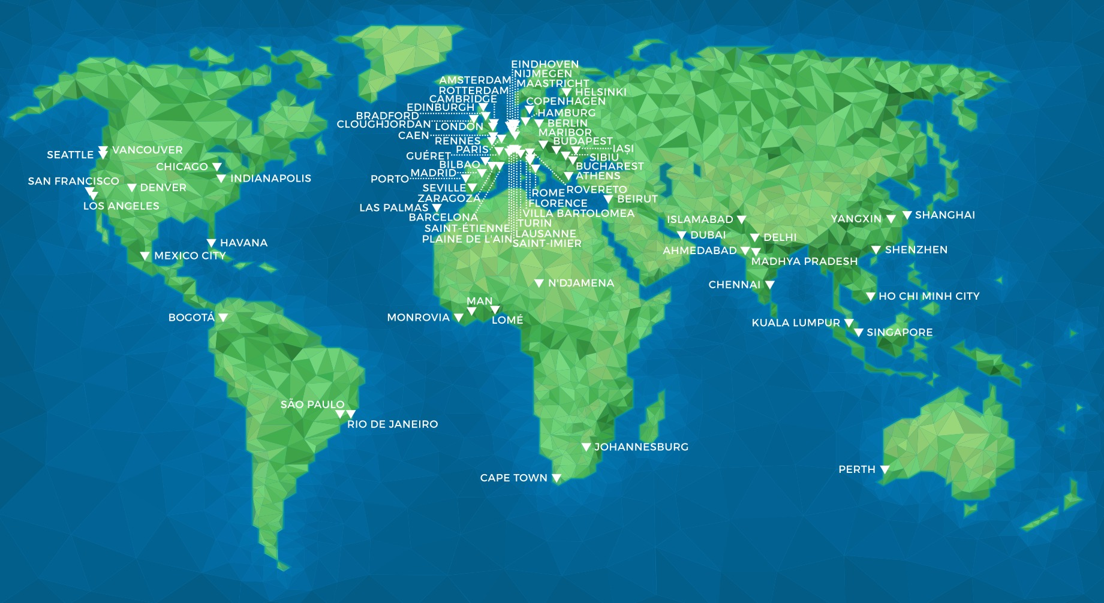
Since 2015: 100+ locations across the globe

Slide 4
Open Source
as the key to the
Circular Economy
* Enables Transparency &
* Distributed Forms Of Collaboration
* Needs to be there from the Start!

Slide 5
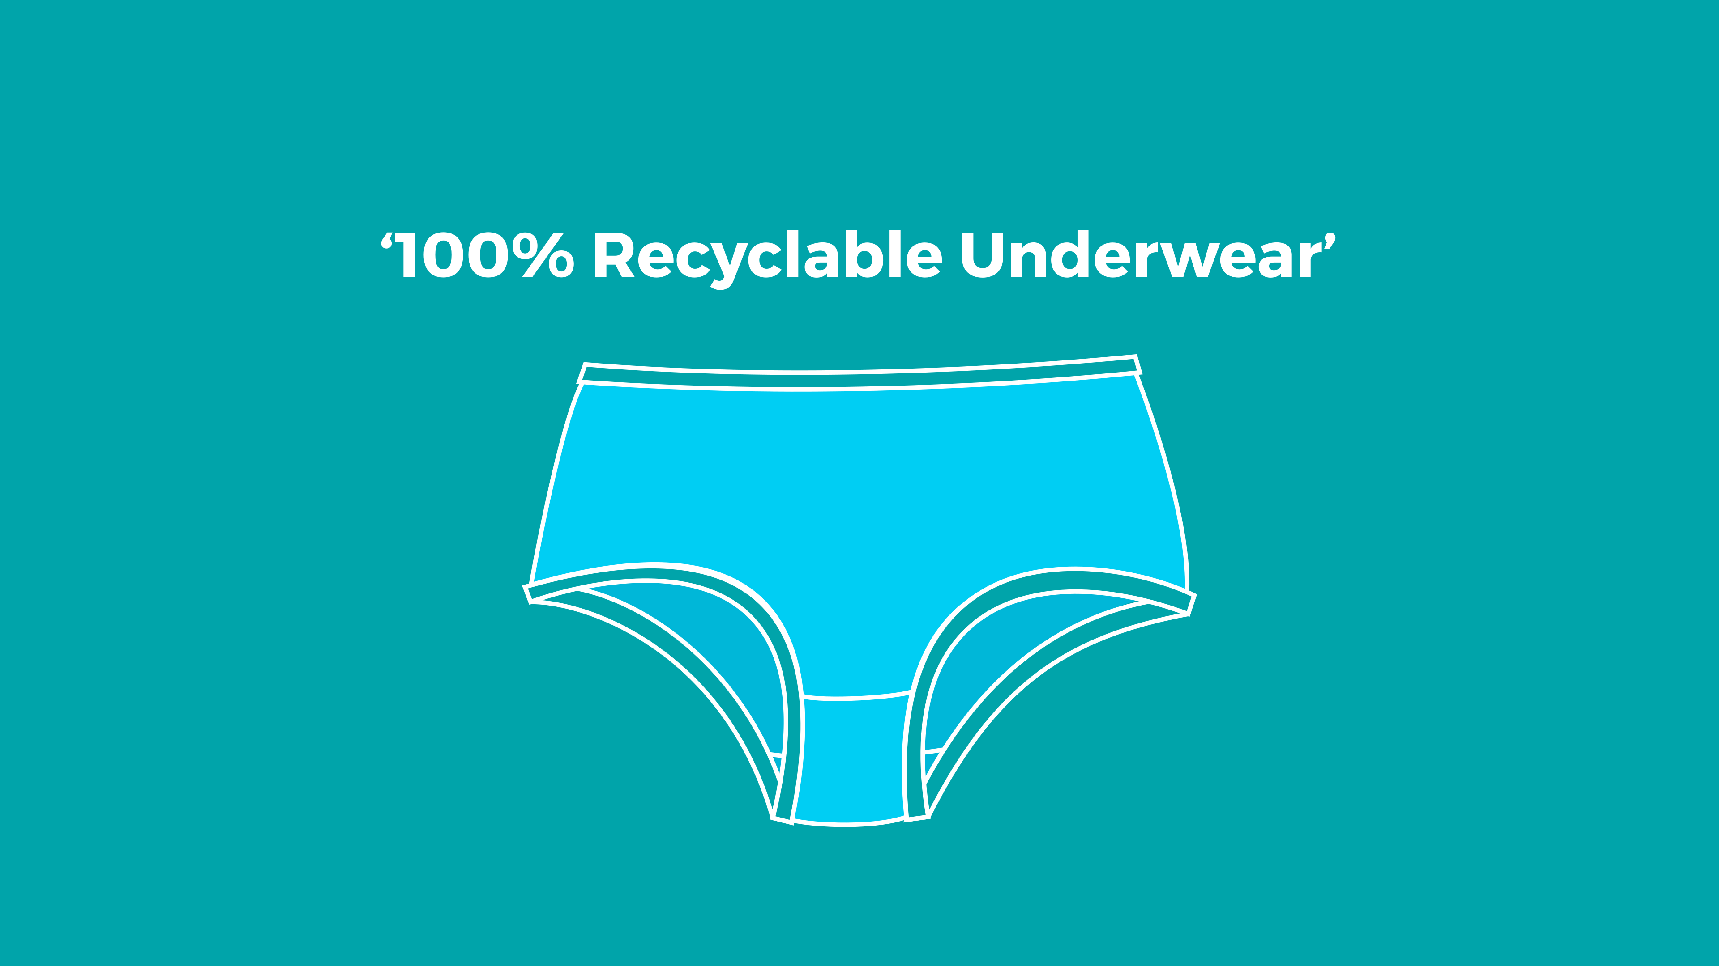

Slide 6
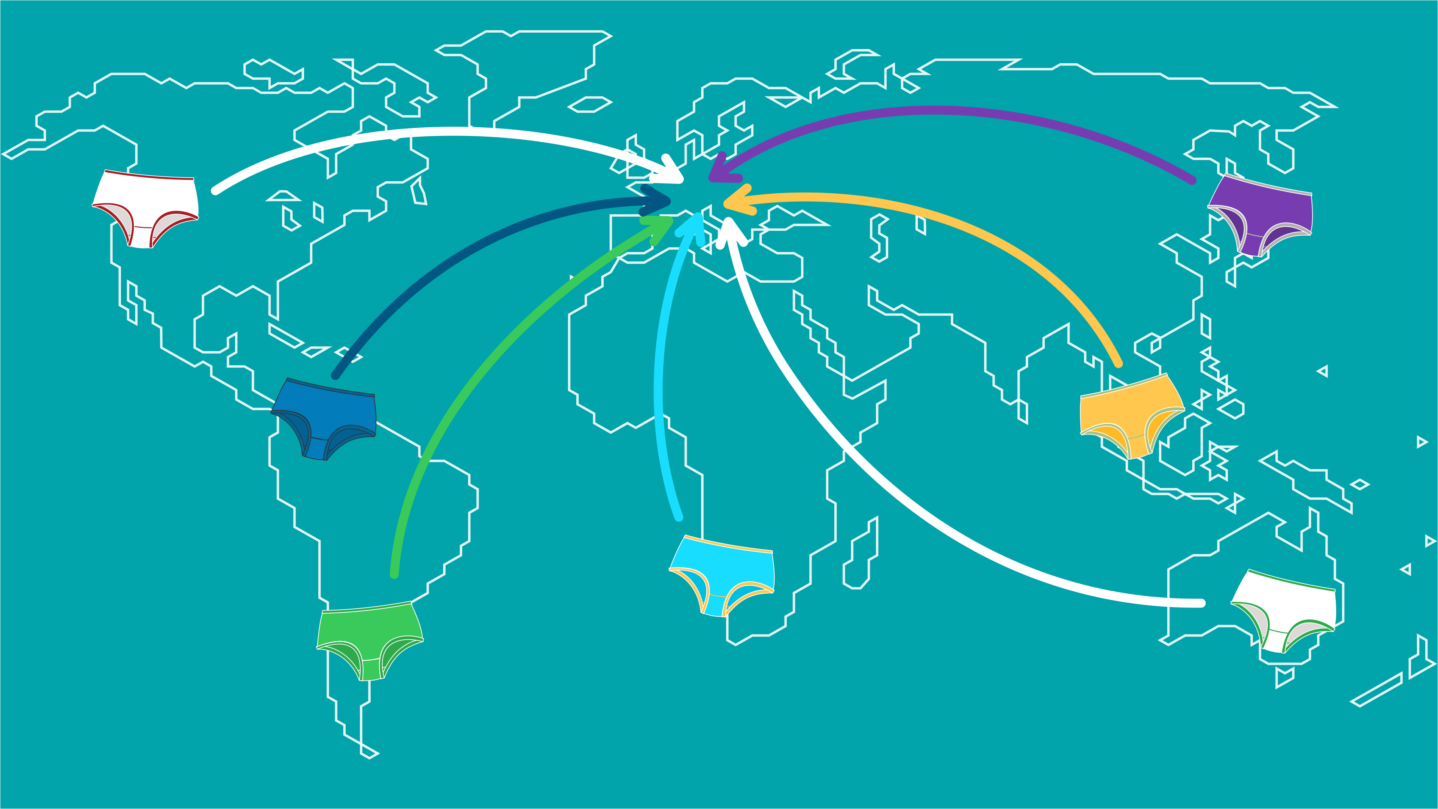
?

Slide 8
Open source hardware is hardware whose design is made publicly available so that anyone can study, modify, distribute, make, and sell the design or hardware based on that design.
oshwa.org/definition

Slide 9
But How To Make
Business With Open Source?
Full Online Course at:
oscedays.org/b1

Slide 10
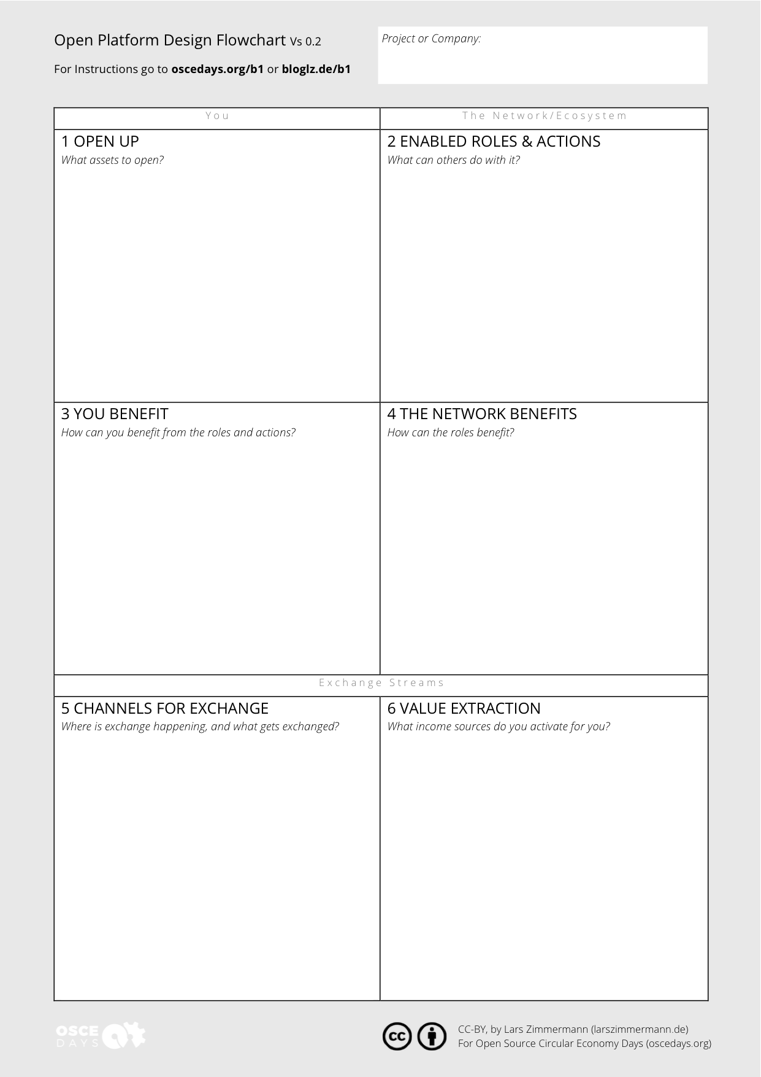
oscedays.org/b1

Slide 11
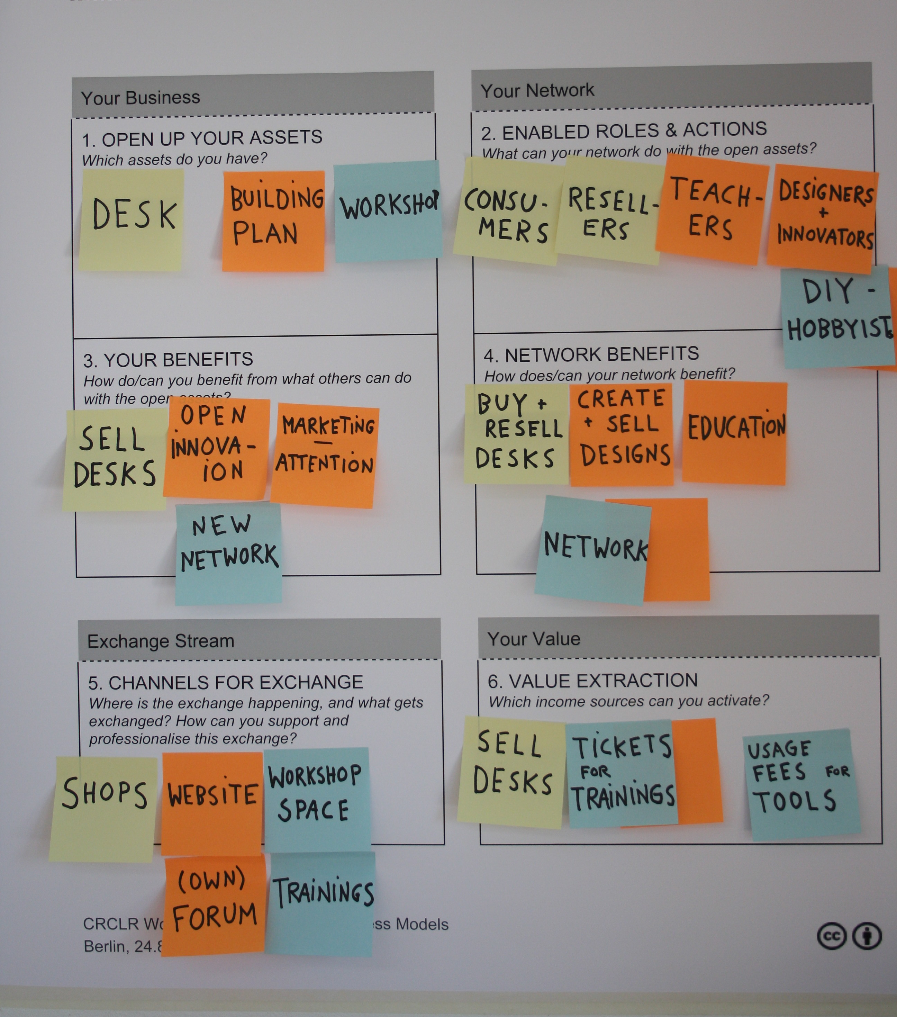

Slide 12
Open Up (Assets) Roles
Products
Product
Designs
Customers
Resellers
Designers
Innovators
Packaging
Designs
Stores
Teachers
Packaging
Providers
Freight
Logistics
Customers, Designers, Innovators
Your Benefits Networks Benefits
Sell Products
Buy, Resell
Products
Open
Innovation
Marketing,
Attention
Create &
Sell Designs
Education
Reduced In-
novation Costs
New Network/
Communities
Business
Opportunity
New Network/
Communities
More Effecive Logistics
Access To Freight Infrastructure
Channels Value Extraction
MORE INFO: oscedays.org/b1
Stores Incl.
Online
Website
Sell Products
Loyal
Customers
Website
in-store
Cheaper Standar-
dized Packaging
Website
Sell Tickets
Workshop Space
Sell Subscriptions
Sell Freight
Capacity
Trainings
Platform
Loyal Customers

Slide 13
Full Online Course At:
oscedays.org/b1

Slide 14
Seek Help Here
Us (OSCEdays; GE, BR)
Simone Cicero (Platform D. Toolkit; IT)
Diderik Van Wingerden (NL)
Danish Design Center (DK)
Jaime Arredondo (FR)
Benjamin Tinq (Ouishare; EU)
Paul Bristow (Geneva; CH)

Slide 15
THANK YOU
Seigo Robinson
@seigorobinson
socialcirculareconomy.com
Lars Zimmermann
@bricktick
larszimmermann.de

Slide 16
Open Up (Assets) Roles
Products
Product
Designs
Customers
Resellers
Designers
Innovators
Packaging
Designs
Stores
Teachers
Packaging
Providers
Freight
Logistics
Customers, Designers, Innovators
Your Benefits Networks Benefits
Sell Products
Buy, Resell
Products
Open
Innovation
Marketing,
Attention
Create &
Sell Designs
Education
Reduced In-
novation Costs
New Network/
Communities
Business
Opportunity
New Network/
Communities
More Effecive Logistics
Access To Freight Infrastructure
Channels Value Extraction
MORE INFO: oscedays.org/b1
Stores Incl.
Online
Website
Sell Products
Loyal
Customers
Website
in-store
Cheaper Standar-
dized Packaging
Website
Sell Tickets
Workshop Space
Sell Subscriptions
Sell Freight
Capacity
Trainings
Platform
Loyal Customers

