Slide 1
ENERGY IN THE OPEN SOURCE CIRCULAR ECONOMY ESWcon 2018 Georgia Institute of Technology
Silvia Leahu-Aluas MSME, MBA
Atlanta, GA
April 2018
CC BY-NC 4.0
Notes:
The entire presentation is licensed under Creative Commons Attribution-Non Commercial 4.0 International (CC BY-NC 4.0)

Slide 2
Agenda
Why and what do we have to change?
Open Source Circular Economy – definition and opportunities
Energy – 100% renewable, sustainable
Energy in OSCE - success stories
Q&A

Slide 3
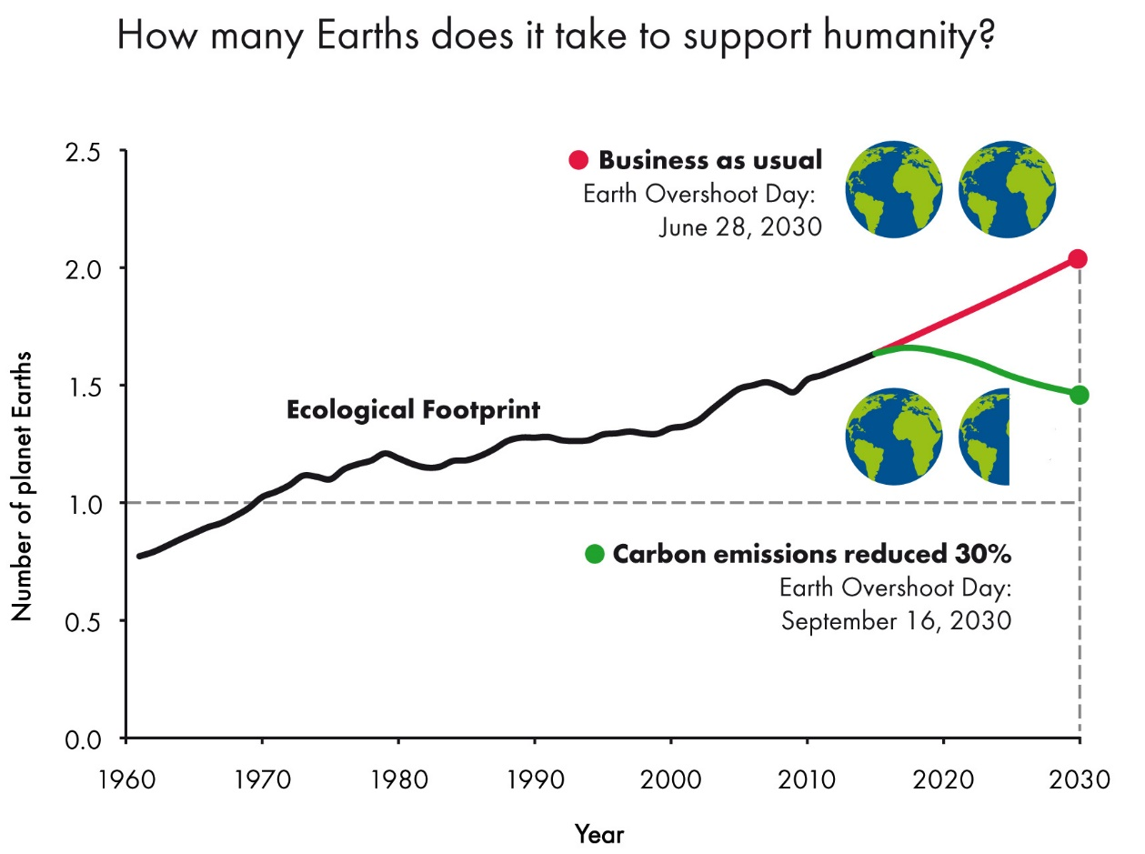
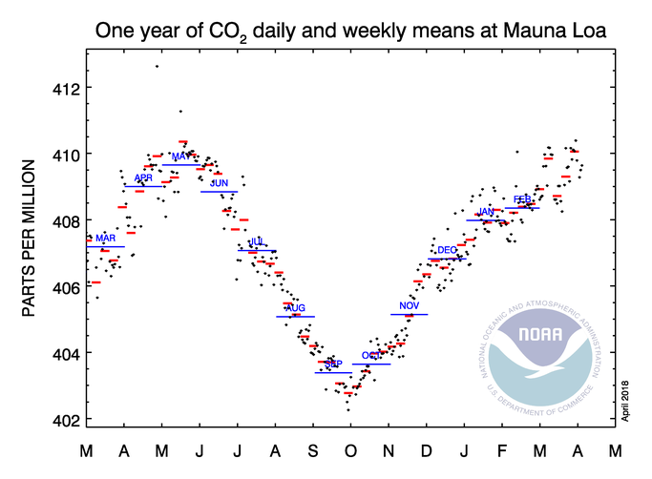
ANTHROPOCENE - UNSUSTAINABLE TRENDS
https://www.footprintnetwork.org/our-work/ecological-footprint/
http://www.esrl.noaa.gov/gmd/ccgg/trends/weekly.html
Notes:
At present we need 1.7 planets to support humans’ demand on Earth’s ecosystems
Self-inflicted scarcest resource : time; we are running out of time to reverse the negative impact that humans impose on our planet’s capacity to sustain its biosphere
Should we give up then? No, engineers like you and me and many other people, all over the world, are working with great competence, passion and determination to bring our planet back on a sustainable path

Slide 4
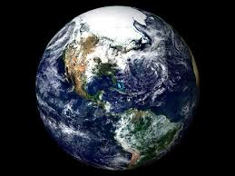
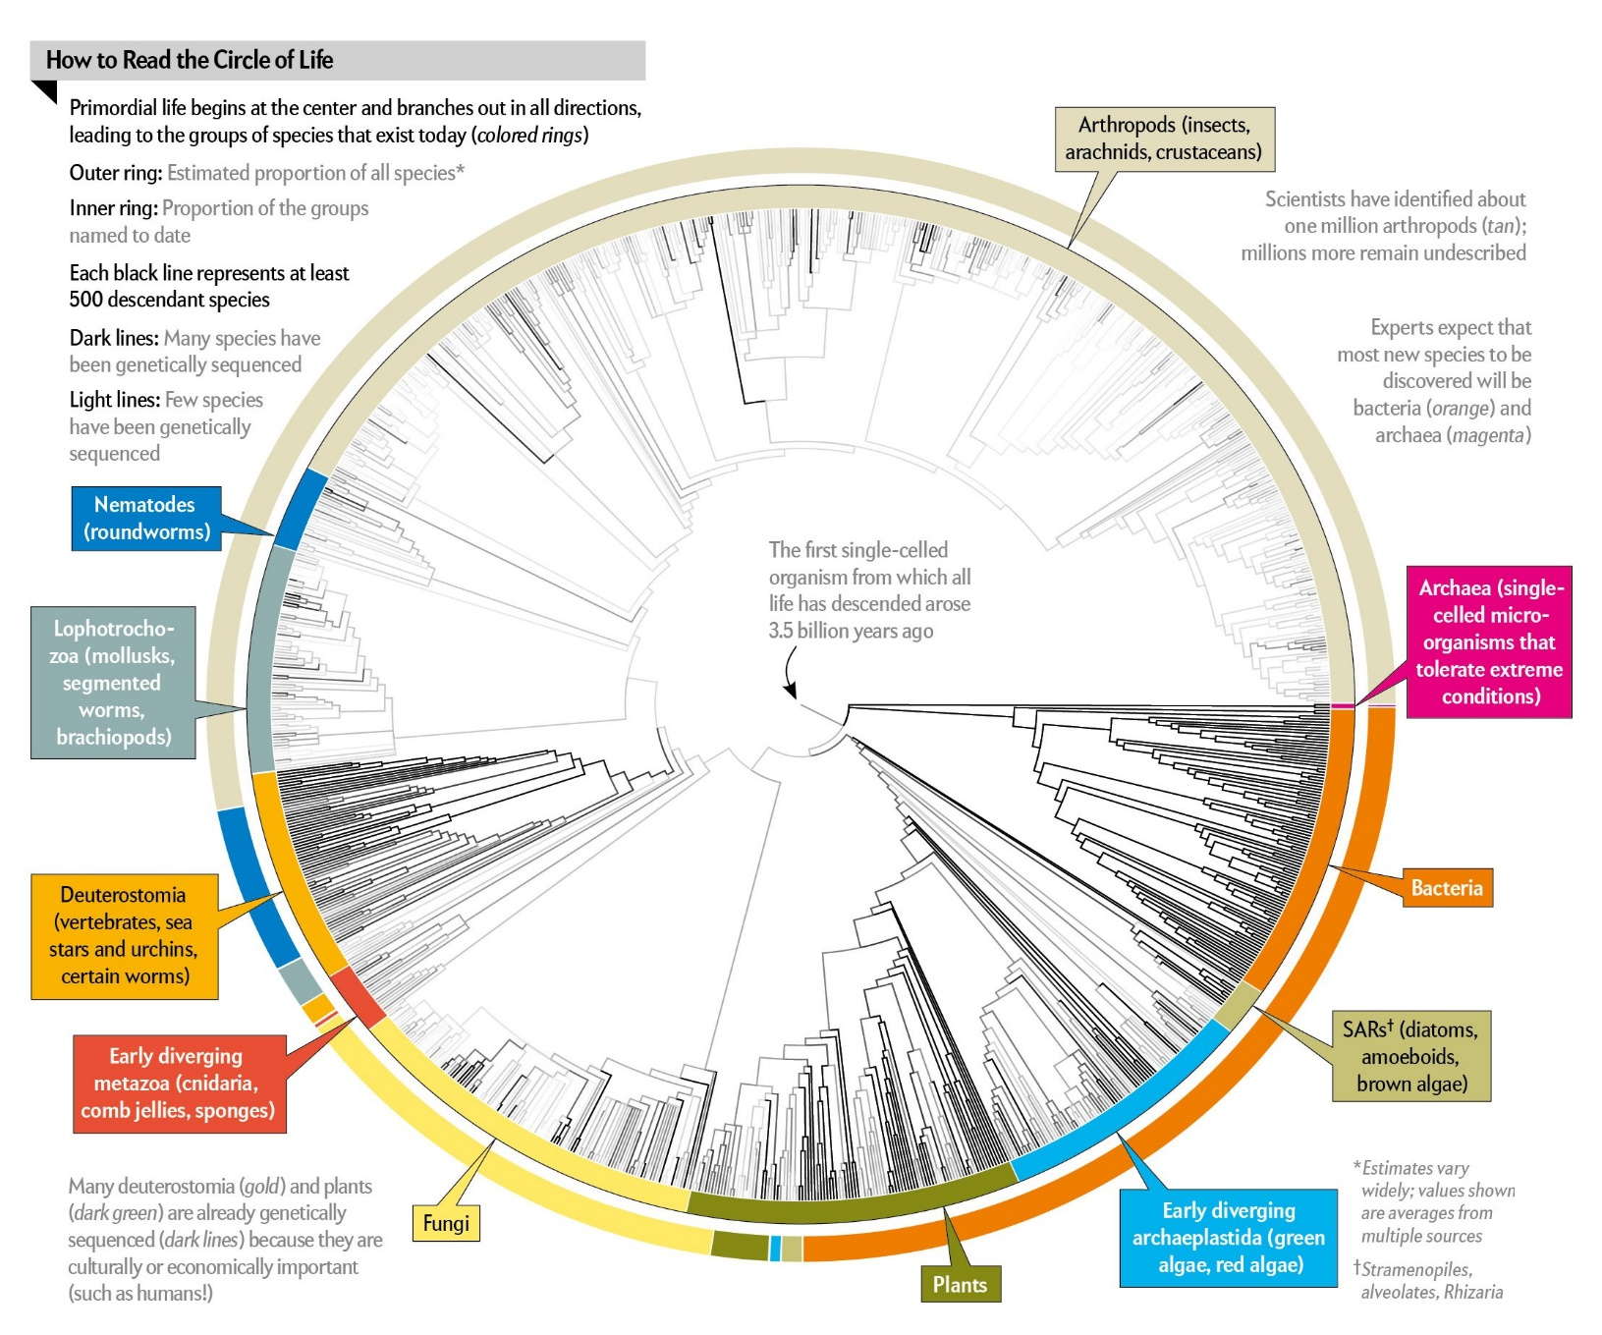
Homo Sapiens is one of more than 2.3 million species identified by science at present
https://www.scientificamerican.com/article/all-2-3-million-species-are-mapped-into-a-single-circle-of-life/
Notes:
Earth is the only planet, we know of, that has a biosphere, that can sustain life and human civilization
There is no Planet B, we don’t know of any or it’s too far for us to ever be able to “move”
Nature, both biotic and abiotic, exists without us, humans, vice versa is not possible – we tend to forget that, we have become “the most invasive species”

Slide 5
SUSTAINABILITY
DIMENSIONS
SOCIETY
NATURE
ECONOMY
Notes:
Economy depends on society and both depend on nature
We are the only species that has an economic dimension
It is the way we have structured the economy, especially in Anthropocene, and the disproportionate role it has in our lives that put us and the planet on an unsustainable path
Therefore, it is the economy that we have to change first, its principles, its goals and its role

Slide 6
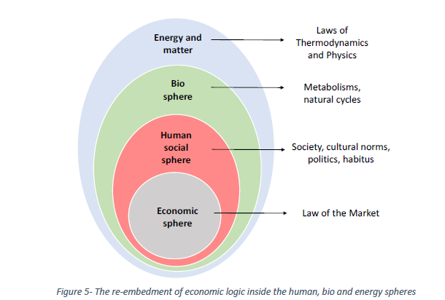
Notes:
Source: http://commonstransition.org/wp-content/uploads/2017/10/Report-P2P-Thermodynamics-VOL_1-web_2.0.pdf
Economy depends on society and both depend on nature
To change the economy, we need the public conversation and policy to be anchored rather in science (biology, ecology, physics, etc.) than current mainstream economics
It is the economy that we have to change first, its principles, its goals and its role

Slide 7
ANTHROPOCENE – SUSTAINABILITY SINE QUA NON
Sustainability is the ability to endure for organisms, systems, processes
Sustainability allows all of us to have a good life within the Earth’s finite capacity while sharing it with all the other species and keeping the beauty and value of non-living things intact
Sustainability supports an advanced civilization within Earth’s planetary boundaries
There is a constant exchange of resources and constraints between the 3 dimensions: economic, social and natural; sustainability allows us to perform optimally on all 3
Sustainability is the ultimate goal of the changes we need to make, urgently
Notes:
What motivates us all Engineers for a Sustainable World
Same for all the people in the Open Source Circular Economy community

Slide 8
Agenda
Why and what do we have to change?
Open Source Circular Economy – definition and opportunities
Energy – 100% renewable, sustainable
Energy in OSCE - success stories
Q&A

Slide 9
CIRCULAR ECONOMY
Industrial model designed and managed around circular flows of resources, products, processes that are
Renewable, long-lasting, high value
Low carbon, low entropy, low waste
Non-toxic, clean, nourishing, healthy
The concept was developed in industrial ecology and prescribes industry as a human-made ecosystem operating on the same principles as the natural ecosystem
Similar concepts: blue economy, industrial symbiosis, by-product synergy, steady-state economy, industrial ecology, eco-industrial parks, bio-based economy, farm-to-factory, wellbeing economy

Slide 10
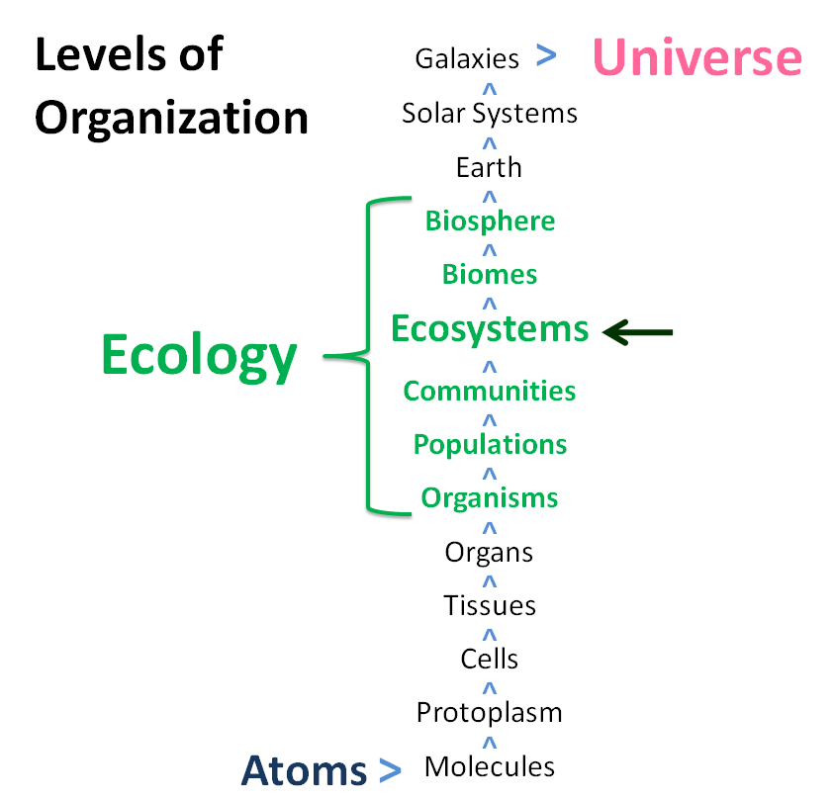
An ecosystem is a community of organisms interacting with each other and with their environment such that energy is exchanged and system-level processes, such as the cycling of elements, emerge.
Ecosystems include living organisms, the dead organic matter produced by them, the abiotic environment within which the organisms live and exchange elements (soils, water, atmosphere), and the interactions between these components. Ecosystems embody the concept that living organisms continually interact with each other and with the environment to produce complex systems with emergent properties, such that "the whole is greater than the sum of its parts" and "everything is connected".
http://www.eoearth.org/view/article/152248/
Notes:
Principles of operation of the non-human natural ecosystem, that’s what we need to base the economy on
There are many economists and economic models that help us make the necessary changes, we need to bring them mainstream
Open Source Circular Economy is one of those models

Slide 11
Open Source
is a successful collaboration method for developing
software, hardware and design. It is based on
transparent (and often distributed) development,
and the open sharing of files and solutions.
Notes:
There is no copyright, patent, IP in non-human nature
Open source means publishing how things are made, such as a recipe, software code, production data, or design files so that anyone can study, use, and build upon this information. This often occurs through decentralized and distributed collaboration: diverse groups discussing project ideas, giving feedback, fixing bugs, prototyping solutions and building useful, customizable software, hardware, tools and culture.
One of the best ways to select and scale up the most effective solutions, fast
Open source software is well understood and used, we at OSCEdays want to expand its success into hardware, technical and business processes

Slide 12
Open Source Circular Economy
We believe that a sustainable, waste free,
circular economy needs transparency,
open access to information
and open source solutions.
Open Source Circular Economy Community
Notes:
The merger of the two concepts and models for the purpose of accelerating the adoption of the circular economy by using the mindset, talent and principles of the experts, makers, hackers and tinkerers of the world who want to create, make, share, collaborate around a common purpose of sustainable living for all.
A model that has a better chance of being adopted at a global scale as it is built at grassroots level by people whose goal is a sustainable planet
A way to make the Commons a success, instead of a tragedy

Slide 13
Natural nuclear fusion power plant
Virtually free, infinite
Renewable and clean
Fundamental to life on Earth
Global impact
Earth’s Biogeochemical and Hydrological Cycles
Maintain
Reduce/Eliminate
Reuse
Increase/Maintain
Virgin
Renewable
Toxic
Non-toxic
Remanufacture
Socially bad
Non-virgin
Non-renewable
Socially good
Recycle
Energy/Material Flows
Energy/Material Flows
Nourish
C, H, N, O, P, S
Life’s Essential Elements
Minimize irreducible waste/leakage
Create feedstocks that do not disrupt Earth’s cycles
Notes:
All individual and business decisions and actions, no matter how small, lead to large aggregate impacts
Always think about and assess the consequences on the systems outside your particular business/industry/market
OSCE brings human life and activities in balance with Earth’s main cycles and finitude
OSCE brings human-made world in balance with the natural world where diversity, resilience, redundancy, smallness, interdependence, waste-is-food, slowness are the keys to survive and thrive

Slide 14
Local action
PRODUCT CIRCLES
BIO-BASED/NATURAL MATERIALS
TECHNICAL/SYNTHETIC MATERIALS
$
$
LOCAL SYMBIOSIS
Notes:
OSCE is a solution to the wicked problems we have created in the last 300 years
Operates on two planes
Product circles within flows of natural and technical materials between producers, servicers and users
Growth and disposal are replaced by circles of maintenance, long-lasting value and usage
Local symbiosis connects market and non-market stakeholders with the shared goal of prosperity and sustainability for all
In both planes, avoidable waste is not acceptable
For every waste flow, feedstock demand is searched or created

Slide 15
Agenda
Why and what do we have to change?
Open Source Circular Economy – definition and opportunities
Energy – 100% renewable, sustainable
Energy in OSCE - success stories
Q&A

Slide 16
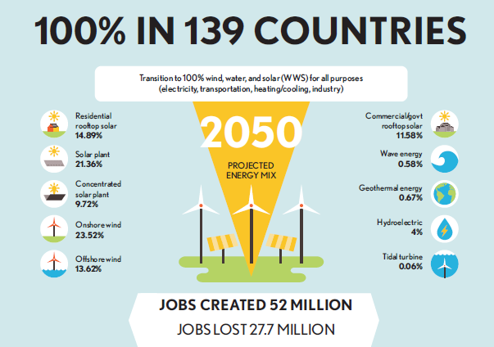
The Solutions Project - Data from Stanford University
Notes:
Only renewable and clean resources, energy and materials, can be used in the circular economy or any other sustainable economic model
Fossil-based economy is the main cause of climate change, it has to be replaced…and there is no “clean coal” or clean any fossil fuel
We have the roadmaps, just need to race against time to achieve their goals

Slide 17
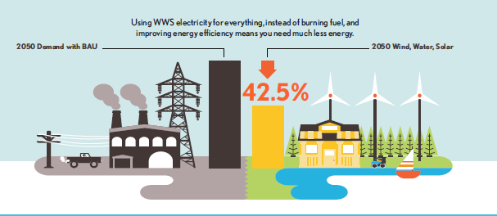
The Solutions Project - Data from Stanford University
Notes:
Added benefit of significantly improved energy efficiency

Slide 18
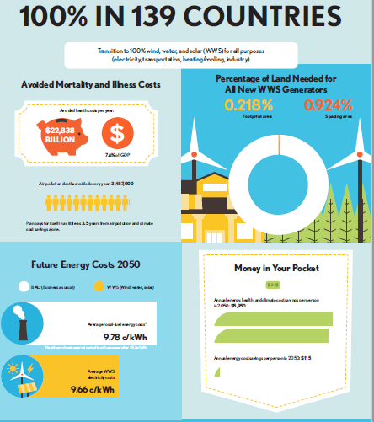
The Solutions Project - Data from Stanford University
Notes:
The roadmaps include impact on all 3 sustainability dimensions

Slide 19
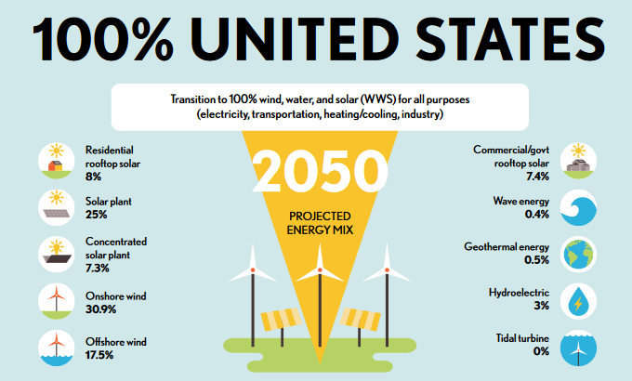
The Solutions Project - Data from Stanford University
Notes:
There is a detailed roadmap for every US state
Whether you work in the energy industry or in any of its customer industries, use these or other 100% renewable energy roadmaps in your engineering choices
Does it mean that if we run on 100% renewable, sustainable energy we can revert to the current growth driven economy? No.
Materials, water, land are still finite
Even if some materials are renewable the time scale needed is larger than the rate of depletion
Humans still have to share the biosphere with all the other species
Matter and energy still degrade as per the immutable 2nd law of thermodynamics
What we accomplish with 100% renewable, sustainable energy is to restore the balance between humans and the rest of the planet that allowed Homo Sapiens to evolve and thrive in the last ~200,000 years

Slide 20
Agenda
Why and what do we have to change?
Open Source Circular Economy – definition and opportunities
Energy – 100% renewable, sustainable
Energy in OSCE - success stories
Q&A

Slide 21
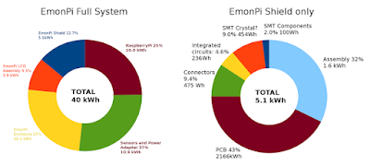
Embodied energy and lifecycle analysis of an open hardware energy monitor
OSCEdays Project – London June 2015
Open-energy-life-cycles
Notes:
Key challenger: https://openenergymonitor.org/
One of the goals: to make a contribution to the conversation about the embodied energy and lifecycle impact of electronics
Explored the embodied energy and lifecycle impacts of one example open hardware product which also happens to be an energy monitor called the EmonPi
Embodied energy, a value that engineers need to be able to assign to all materials and products

Slide 22
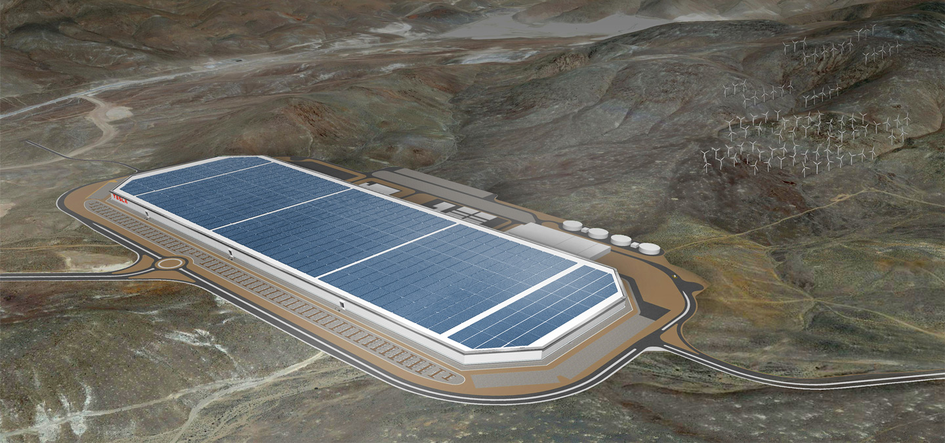
100% Renewable Energy Factory
Tesla Gigafactory
Notes:
"This factory will produce its own energy as well. Through a combination of geothermal, wind and solar it will produce all the energy it needs," Musk said. "So it'll be sort of a self-contained factory." Source: https://www.computerworld.com/article/2604352/if-tesla-s-gigafactory-can-run-on-100-renewable-energy-why-can-t-others.html

Slide 23
Tesla Electric Vehicles – Open Source
“Tesla Motors was created to accelerate the advent of sustainable transport. If we clear a path to the creation of compelling electric vehicles, but then lay intellectual property landmines behind us to inhibit others, we are acting in a manner contrary to that goal. Tesla will not initiate patent lawsuits against anyone who, in good faith, wants to use our technology.
Given that annual new vehicle production is approaching 100 million per year and the global fleet is approximately 2 billion cars, it is impossible for Tesla to build electric cars fast enough to address the carbon crisis. By the same token, it means the market is enormous. Our true competition is not the small trickle of non-Tesla electric cars being produced, but rather the enormous flood of gasoline cars pouring out of the world’s factories every day.
Technology leadership is not defined by patents, which history has repeatedly shown to be small protection indeed against a determined competitor, but rather by the ability of a company to attract and motivate the world’s most talented engineers. We believe that applying the open source philosophy to our patents will strengthen rather than diminish Tesla’s position in this regard.”
Tesla Motors
Notes:
Tesla Motors decision to switch to open source for its electric vehicle is a perfect example of what motivates the open source model and a guarantee of its potential for commercial success
It shows that the OSCE model has a good chance of becoming mainstream, as it is adopted by industrial companies dedicated to sustainability

Slide 24
Energy – Farming Symbiosis
Sun-Raised Farms, North Carolina
http://sunraisedfarms.com
Notes:
Local symbiosis between solar farms, ground maintenance company and family farmers
Sustainable land management
Added benefits for the family farm: new revenue streams, healthy animals

Slide 25
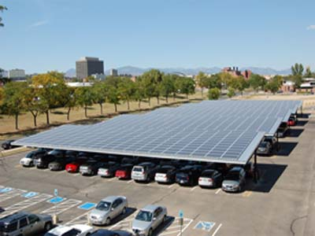
Energy – No Wasted Assets
New revenue streams from repurposing underused/unused physical assets
Locked-in long-term electricity costs
Denver, Colorado Federal Center Buildings http://www.gsa.gov/portal/content/114551
Notes:
All assets should be used for renewable energy generation in OSCE
No wasted physical assets: factory buildings, machinery, equipment, land

Slide 26
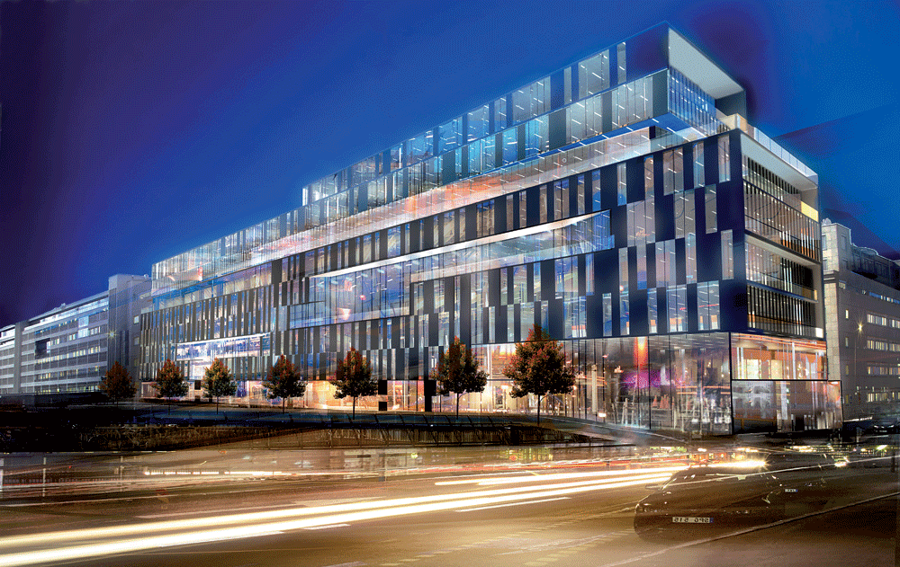
Energy – Highly Innovative Solutions
SymbioCity, Sweden
using human body heat recovered from Stockholm’s Railway Central Station to heat the adjacent Kungsbrohuset building
http://www.symbiocity.org/en/approach/Cases-undersidor/Kungsbrohuset-people-power/
Notes:
Nothing left to waste: excess body heat produced by the some 200 000 commuters that pass by the Central Station every day is recovered and transferred to another building

Slide 27
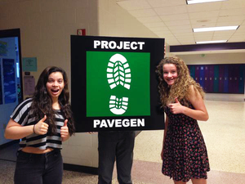
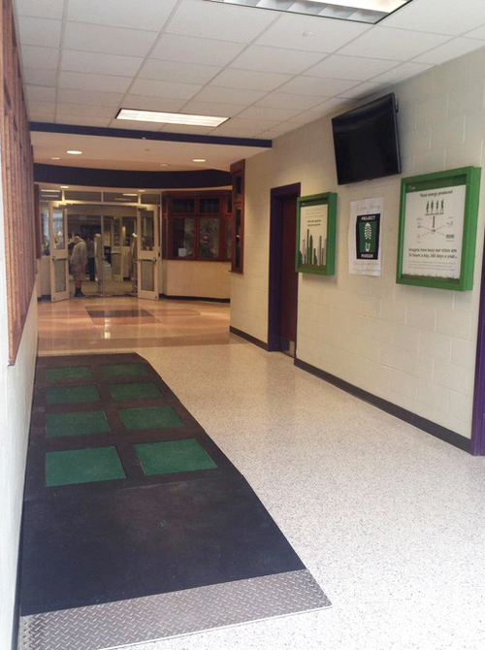
Energy – Highly Innovative Solutions
http://www.pavegen.com/bloomington-schoo
l
Notes:
Nothing left to waste: tiles that generate electricity from footsteps
IU Bloomington solution is “an 8-tile installation within the school’s main entrance that powers educational boards and a phone-charging station. Using our wireless API, the tiles also collected information on the daily amount of footfall, displaying the real-time data on a screen.”

Slide 28
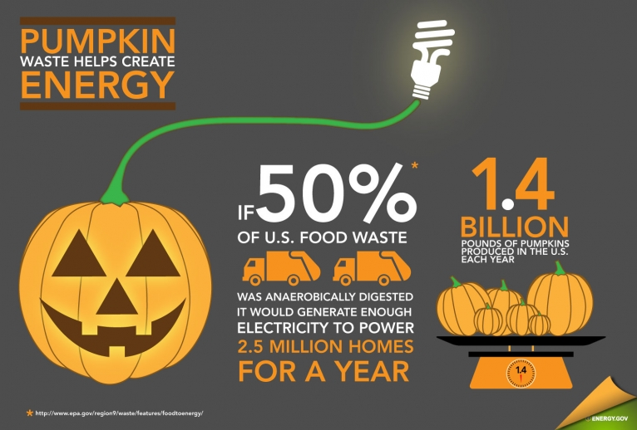
Energy – Farming Symbiosis
http://usgreenchamber.com/pumpkin-power-food-for-thought-and-energy/
Notes:
Food waste should be eliminated
However, as long as it exists, instead of sending it to the landfill, in OSCE it is used to generate electricity

Slide 29
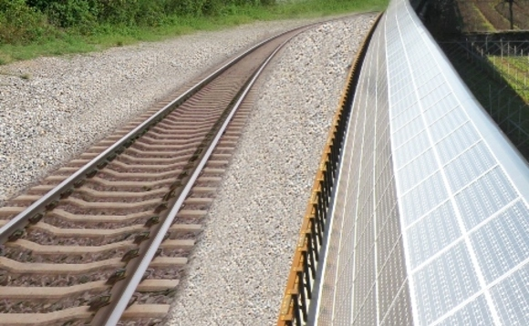
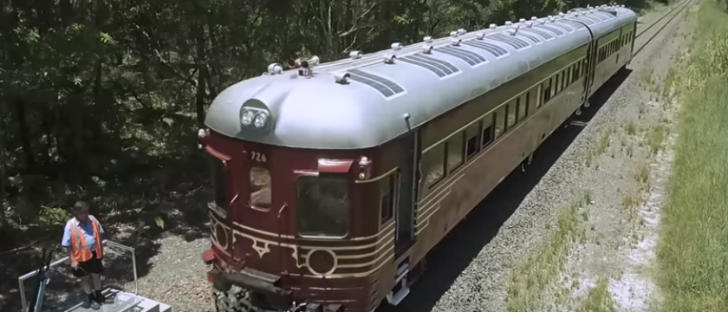
Energy – Mobility System
Network Rail could cut operating costs by £150m between 2019 and 2024 by inviting investors to fund trackside solar arrays.
The world’s first solar powered train was built and is running in Australia by Byron Bay Railroad Company
http://www.businessgreen.com/bg/news/2394661/how-trackside-solar-arrays-could-save-network-rail-gbp150m
https://www.engineersaustralia.org.au/portal/news/australian-solar-powered-train-limelight
Notes:
Transportation and finance are economic connectors
In OSCE they must also use only renewable resources
Rail is the most sustainable means of mass transportation, both freight and passenger
Combining renewable energy, such as solar, with rail transportation is a perfect fit for OSCE

Slide 30
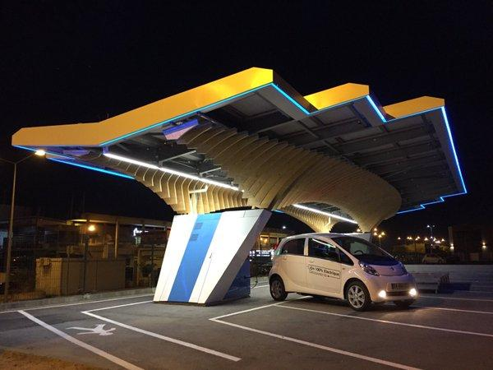
Energy – Mobility System
Parasol® 100% solar energy EV charging station
Corsica, France
Driv-eco Innovator in Solar Mobility
Notes:
Integrated energy-mobility system uses circular economy principles by providing 100% solar energy, using local manufacturing, craftsmanship and skills for building, installation and servicing and a highly innovative design
“Anchored by Parasols®, Driv-eco has recently inaugurated the first “Smart Solar Mobility” road in the world between Bastia and Ajaccio in Corsica, France. Our ambition is to ensure anxiety-free electric driving on 100% solar energy within Corsica, mainland France.”
I’ll end with this success story for a special reason: a favorite engineer of mine, who is a Georgia Tech graduate (an excellent engineering school), is working on this project, my son

Slide 31
Agenda
Why and what do we have to change?
Open Source Circular Economy – definition and opportunities
Energy – 100% renewable, sustainable
Energy in OSCE - success stories
Q&A

Slide 32
“The living world is in desperate condition. It is suffering steep declines in all the levels of its diversity. It will be helped out, but not saved by economic measures of its ecological services and potential products. […]
Only a major shift in moral reasoning, with greater commitment given to the rest of life, can meet this greatest challenge of the century.”
Edward O. Wilson “Half – Earth, Our Planet’s Fight for Life”, 2016
“...useful, low-entropy energy and materials are dissipated in transformations that occur in economic processes, and they return to the environment as high-entropy wastes. The economy, then, functions as a conduit for converting natural resources into goods, services, human satisfaction, and waste products. Increasing entropy in the economy sets the limit on the scale it can achieve and maintain.”
Nicholas Georgescu-Roegen “The Entropy Law and the Economic Process”, 1971

Slide 33
https://oscedays.org/
Many thanks to the ESWcon 2018 organizers, hosts, sponsors and participants
Silvia Leahu-Aluas
Open Source Circular Economy Consultant
CC BY-NC 4.0
Engineers for A Sustainable World
Notes:
The entire presentation is licensed under Creative Commons Attribution-Non Commercial 4.0 International (CC BY-NC 4.0)

Slide 34
Back-up

Slide 35
The evolution of sustainable manufacturing concepts and practices
WTEC Panel Report on Environmentally Benign Manufacturing (2001), Fig 4.1 p. 33
Notes:
We live in a technologically advanced industrial civilization
Engineering is fundamental to its continuing maintenance and progress on a sustainable path
Whether you realize it or not, every single action you take, small or big, in your work as engineers, has a major impact on all 3 sustainability dimension
Every single action you take as engineers has an impact on the type, amount, efficiency and effectiveness of energy at local and global level
Engineers have a lot of power, explicit or implicit, we have to use it well
35

Slide 36
Thermodynamics refresher:
1st law: Energy cannot be created or destroyed, only transformed from one form to another
we don’t consume or produce energy, we use or convert energy
2nd law: The quality of energy degrades over time. Natural processes tend to move towards a state of greater disorder.
what we consume is exergy, the energy component that allows us to do useful work
Energy and matter are convertible into each other, all the materials and products we use have embodied energy
Energy is the most valuable raw “material” we have
Notes:
To avoid any disappointment or illusions we have to be guided by the immutable laws of nature. We cannot unscramble the egg!
There is no technology we can create to allow for a perpetuum mobile or “perpetuum circulare”.
Let’s be realistic about the promise of the circular economy, but also embrace it as the most in tune with natural processes instead of a separate human artifact that can operate under imaginary laws

Slide 37
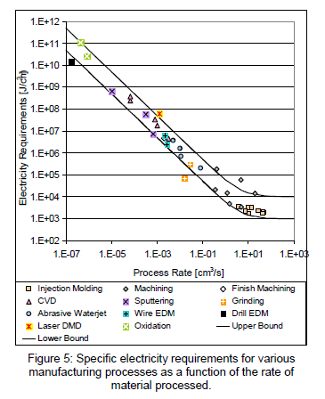
MANUFACTURING PROCESSES
“…1) the specific
energy requirements for manufacturing processes are not constant as many life cycle analysis tools
assume,
2) the most important variable for estimating this energy requirement is the process rate, and
3) the trend in manufacturing process development is toward more and more energy intensive processes.
The analysis presented here also provides insight into how equipment can be redesigned in order to be
more energy efficient.”
Timothy Gutowski, Jeffrey Dahmus, Alex Thierez: Electrical Energy Requirements for Manufacturing Processes http://web.mit.edu/ebm/www/Publications/CIRP_2006.pdf
Notes:
Find the minimum energy, water and material production path instead of maximizing throughput
CVD - chemical vapor deposition
EDM - electric discharge machining
DMD - direct metal deposition

Slide 38
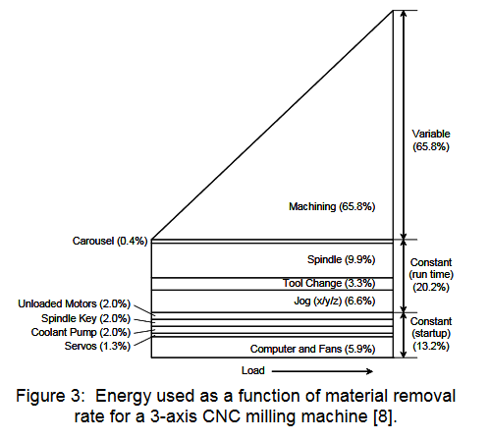
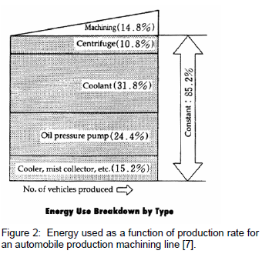
MANUFACTURING PROCESSES
Timothy Gutowski, Jeffrey Dahmus, Alex Thierez: Electrical Energy Requirements for Manufacturing Processes http://web.mit.edu/ebm/www/Publications/CIRP_2006.pdf
Notes:
Find the minimum energy, water and material production path instead of maximizing throughput
CVD - chemical vapor deposition
EDM - electric discharge machining
DMD - direct metal deposition

Slide 39
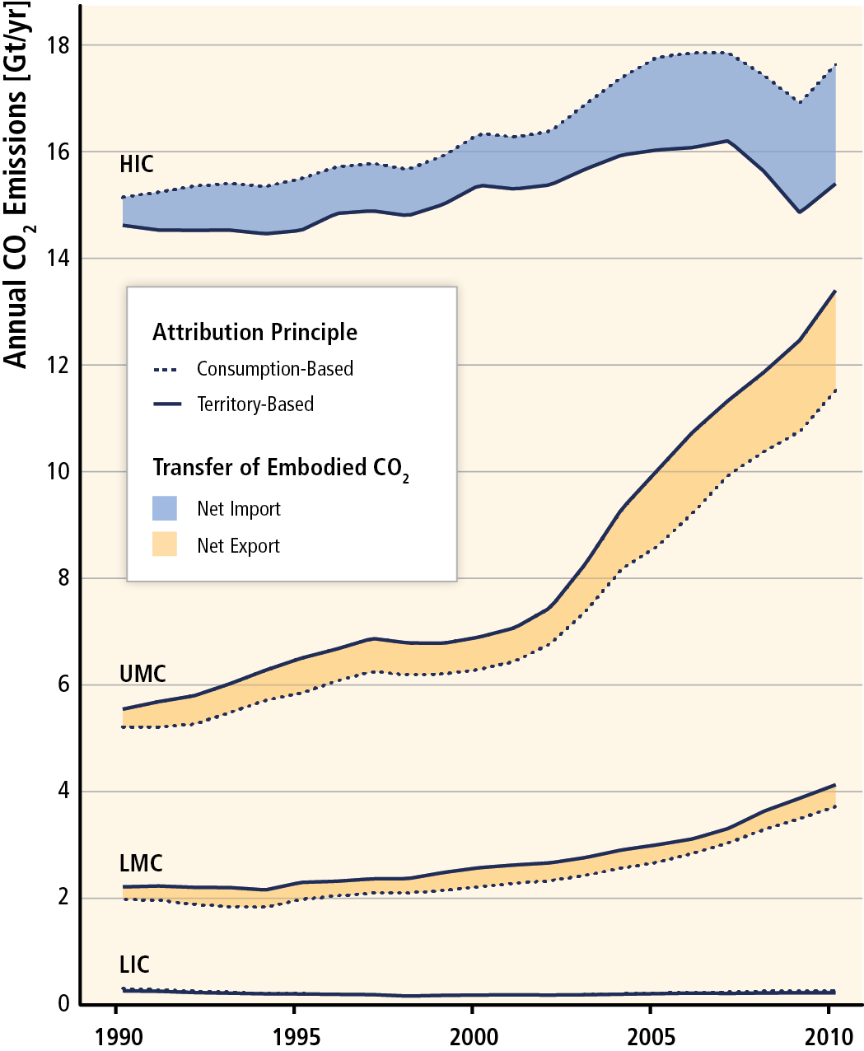
EMBODIED ENERGY/EMISSIONS
http://report.mitigation2014.org/report/ipcc_wg3_ar5_technical-summary.pdf
Notes:
High Income countries (US) are responsible for emissions generated in Upper Middle Income countries (China) and Lower Middle Income countries (Indonesia)
Design drives production/sourcing decisions – take ownsership for both direct and indirect emissions

Slide 40
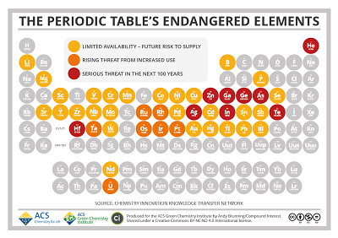
Notes:
Select materials that are abundant, avoid materials at risk of partial or complete depletion

