Slide 1
The Recycling Challenge App
RECYCLING
CHALLENGE

Slide 2
The Recycling Challenge App
RECYCLING
CHALLENGE
What happens to our waste?
Is your neighbour-hood number 1?
UNDERSTAND
See your ranking!
Challenge yourself!
CHALLENGE
Great ideas? Show us!
Let’s meet!
SHARE
What can you recycle?
Weekly waste tips
RECYCLE

Slide 3
Create your account
RECYCLING
CHALLENGE
Your postcode
Your username
Your password

Slide 4
Your borough ranks n°5!
RECYCLING
CHALLENGE
Comments:
Long term content.
Title of the page based on the postcode entered by each App User.
Map based on annual data for now because it is available.
Monthly data would be even more suitable to renew interest of the App Users.
Source for London: http://laportal.wrap.org.uk/LWARBKeyData.aspx

Slide 5
Data inputs – The Borough Map
RECYCLING
CHALLENGE
Enfield
Barnet
Harrow
Haringey
Waltham
Forest
Redbridge
Brent
Isling-
ton
Havering
Hillingdon
Camden
Hackney
Barking
Ealing
West-
minster
Tower
Hamlets
Newham
20-30%
30-40%
40-50%
50-60%
>60%
Ken.
&
Chel.
City
Hammersmith
South
-wark
Hounslow
Greenwich
Wandsworth
Lambeth
Bexley
Richmond
Lewisham
Merton
Kingston
Bromley
Sutton
Croydon
Source for London: http://laportal.wrap.org.uk/LWARBKeyData.aspx

Slide 6
What happens to your waste?
RECYCLING
CHALLENGE
Comments:
Long term content.
Information on how waste is disposed of or recycled.
Format: short 1-2 minutes videos.
Source for the UK: http://www.recyclenow.com/facts-figures/facts-figures
Producing borough-specific information would be ideal.

Slide 7
What can you recycle?
RECYCLING
CHALLENGE
Comments:
Long term content.
Content based on the postcode entered by each App User.
Information on what can or cannot be recycled by borough.
Option to lobby your Council if a specific type of waste is not recycled in your borough by sending the Council an automated email.
Source for London: http://laportal.wrap.org.uk/LWARBBoroughServices.aspx
Borough name
Send a message to your Council!

Slide 8
Waste tip of the week
RECYCLING
CHALLENGE
Comments:
Content added on a weekly basis.
Option to receive notification when new content is added.
Source for the UK: http://www.therubbishdiet.org.uk/top-tips/
Savvy salad saving tips

Slide 9
Challenge yourself!
RECYCLING
CHALLENGE
Comments:
Self-monitoring function.
Asking for the type of bin used will allow to assess the volume of waste per week produced by each App User based on the number of full bins.
What bin do you use
for your normal waste?
45L
25L
10L

Slide 10
Challenge yourself!
RECYCLING
CHALLENGE
Comments:
Self-monitoring function.
Asking for the type of bin used will allow to assess the volume of waste per week produced by each App User based on the number of full bins.
What bin do you use
for your recycling waste?
45L
25L
10L

Slide 11
Challenge yourself!
RECYCLING
CHALLENGE
Comments:
Self-monitoring function.
Asking for the type of bin used will allow to assess the volume of waste per week produced by each App User based on the number of full bins.
What bin do you use
for your food waste?
How many people live in your house?
25L
10L
5L

Slide 12
Challenge yourself!
RECYCLING
CHALLENGE
Comments:
Self-monitoring function.
App Users will have to register each time that they are putting a full bin out.
How much did you waste today?
Number of waste bins
Number of recycling bins
Number of food waste bins

Slide 13
Challenge yourself!
RECYCLING
CHALLENGE
Comments:
Self-monitoring function.
Option to receive weekly and monthly notification of your total waste and total recycling.
Tailored message telling you how you have done compared to the previous week or month.

Slide 14
See your ranking!
RECYCLING
CHALLENGE
Comments:
Self-monitoring function.
App Users will see their ranking compared to all other App Users and to regional averages.
They will be encouraged to go up in the ranking from one week to another.
You rank n°20!
Username | Waste Volume | Recycling Rate

Slide 15
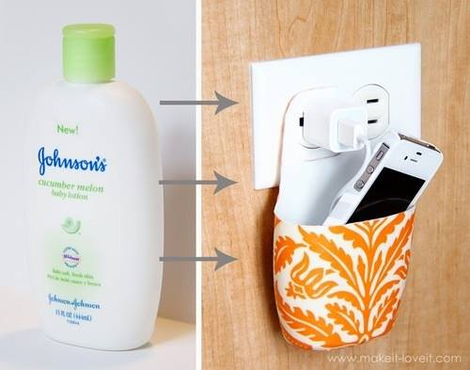
Great ideas? Show us!
RECYCLING
CHALLENGE
Comments:
People can add any picture linked with waste, recycling, reuse, use of recycled material.
Tinder-like function where you can choose pictures that you like or dislike by pushing them on one side or the other.
Picture of the week based on the number of positive votes.

Slide 16
Let’s meet!
RECYCLING
CHALLENGE
Comments:
Function that allows people to organise and broadcast events related to waste and recycling in their borough.
Option to receive notification when a new event organised in your borough is added.
Borough | Event | Details

Slide 17
Further references
RECYCLING
CHALLENGE
Comments:
Links to key organisation’s websites and reports on waste and recycling.

